Slide 1

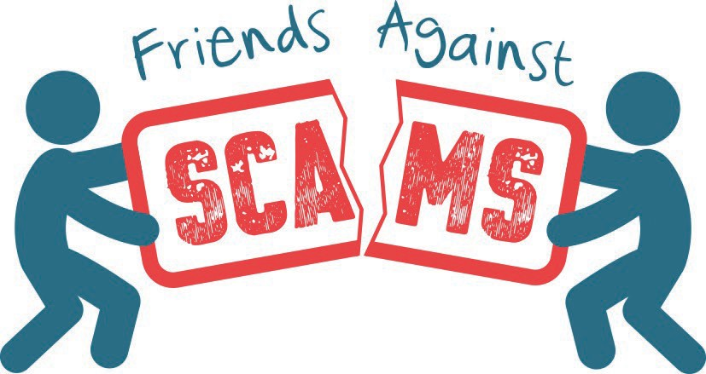
Young Friends Against Scams
#ScamAware
www.friendsagainstscams.org.uk
Notes:
Start by making introductions. Explain to the students that you are going to talk to them about Friends Against Scams.
Explain that Friends Against Scams was created by the National Trading Standards Scams Team in 2016 to protect and prevent people from becoming victims of scams by empowering people to take a stand against scams and grow consumer education.
Explain that they will learn about the different types of scams that can affect both them and their families and how to spot a scam victim. With increased knowledge and awareness, they can have conversations with their family and friends about scams to help protect themselves and others.

Slide 2



Let’s talk. What is a scam?
#ScamAware
www.friendsagainstscams.org.uk
Notes:
Tell the students that you are now going to have a short quiz to see what they already know about scams. Ask for answers to encourage discussion.
Start by asking the students what they think a scam is?

Slide 3

Scams check…
Can you tell me about the different methods criminals use to scam people?
A C
B D
Telephone Scams
People might receive lots of phone calls every day. The people calling sometimes pretend they are policemen or from the bank. Sometimes the people calling pretend to be your friend so that they can steal your money.
Postal Scams
People will receive lots of letters that tell them they have won money or that they can read their fortune. They ask people for money in return for their winnings. The letters look very official and sometimes it is hard to tell if it is a scam.
Doorstep Scams
Doorstep criminals visit people at home and might tell them that they need something “fixed”.
They do poor quality work or work that doesn’t need to be done and charge really high prices/fees.
Online Scams
People might be receiving suspicious emails or visiting criminal websites without even realising it! By clicking on these links, the criminals want to steal your personal information.
Notes:
Ask the students if they can tell you the four types of scam before revealing the four answers. Some answers will be known, offer them a label in your response - for example “person selling dodgy stuff at your door” this can be answered by identifying it with the label “Doorstep Scam”.
Talk to the students in more detail about the four types of scam as you bring them up on the PowerPoint.

Slide 4





I wonder…
Why might people become a victim of a scam? Anyone can be a scam victim…
Circumstances
Lonely
Pressure
Circumstances
All of us go through things that could lead to us becoming a scam victim.
Life events like losing a job, losing a family member or moving home. We all deal with these differently, but they can make us stressed and not think clearly.
Lonely
Scam victims often live on their own and want
Pressure
The criminals put lots of pressure on people
someone to talk to and the to respond to a scam.
criminals appear friendly
People might be too
to build a relationship with scared or embarrassed
the victim, so they trust the criminal.
to talk to someone about what’s happening.
Notes:
Ask the students for their thoughts before revealing the answers.
Talk about some of the issues that people can face that make them more likely to become a victim to a scam.

Slide 5

Think…
Do you think only old people are scam victims?
No
Anybody can be a victim
Yes
No
Even young people get scammed!
Notes:
Ask the students for a hands up on this question.
It is important to highlight the fact that anyone can become a victim of a scam. Although many postal scams are targeted at older people, there are now scams that specifically target young people through text messaging and social media.

Slide 6


What do we know…
How many people in the UK get targeted by scams?
Hundreds
Thousands Millions
Notes:
With this question, you could ask for a show of hands for each answer.
Make it clear that this is problem does not just affect a few people – it affects the lives of millions of people. Some may only have a small amount stolen, whereas others may have life savings taken from them.

Slide 7


Have a think…
What % of people targeted by scams didn’t feel able to tell a friend or family member?
5%
40%
66%
Notes:
With this question, you could ask for a show of hands for each answer.
Make it clear that this is problem with how people treat scam victims, emphasise the need to stop victim blaming

Slide 8



Let's think…
Most scam victims are rich…
False
Anybody can be a scam victim no matter how much money you have!
True
False
Notes:
Again, ask for a show of hands for each answer. Criminals will target anyone and they will then try to get all the money that person has available, regardless of how much it is.

Slide 9





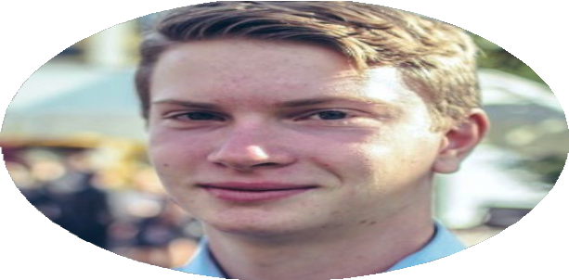
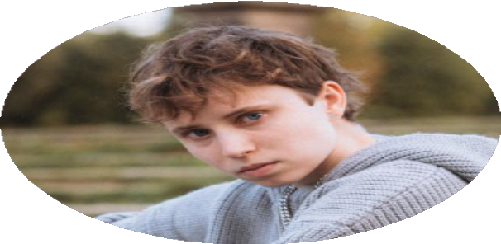


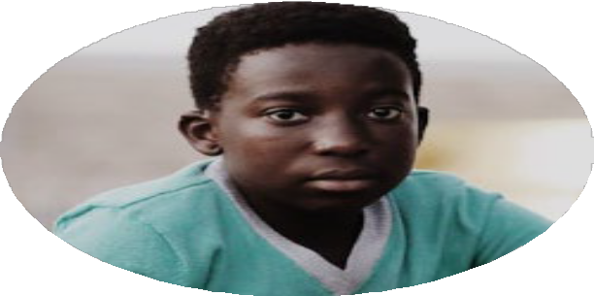

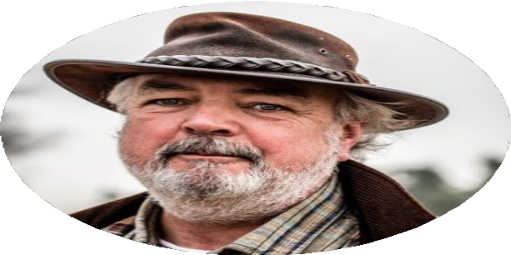




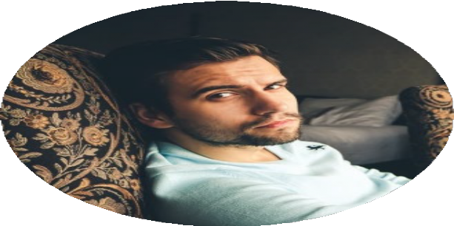
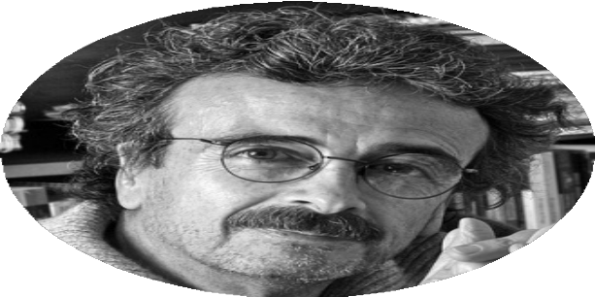
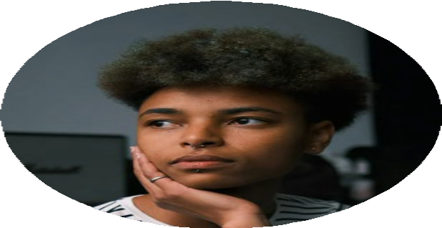
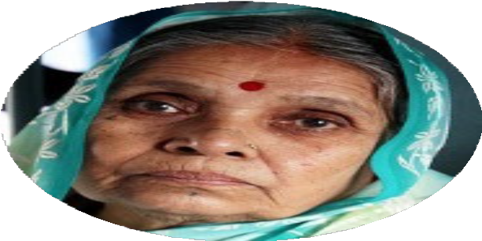


Anyone can be a scam victim.
Healthissue
Debt
Vulnerable
Grief
Lonely
Pressure
Low knowledgeof moneysafety
Targetedby
criminals
Trusteasily
#ScamAware
www.friendsagainstscams.org.uk
Notes:
Emphasise that everyone and anyone could be a victim of a scam, it is down to people’s circumstances as to why they become one. Click through to reveal some of the reasons people become scam victims

Slide 10
Anyone can be a scam victim.
Healthissue
Debt
Vulnerable
Grief
Lonely
Pressure
Low knowledgeof moneysafety
Targetedby
criminals
Trusteasily
#ScamAware
www.friendsagainstscams.org.uk
Notes:
Emphasise that everyone and anyone could be a victim of a scam, it is down to people’s circumstances as to why they become one. Click through to reveal some of the reasons people become scam victims. Emphasise that scam victims are not to blame (no blame no shame). (click 7) - Having no/low knowledge of how to be safe with money means you are more likely to become a victim of scams, and therefore have money stolen from you

Slide 11




Have you ever seen a scam aimed at you?
#ScamAware
www.friendsagainstscams.org.uk
Notes:
Ask the students for hands if think they have seen a scam aimed for them. Then lets look at some scams which are targeted at younger people.

Slide 12


Social Media
Social media scams usually appear as promotional deals and high rewarding competitions.
They may have genuine links, use official brand logos and/or links to enter your personal details.
Also beware of ‘online celebrities’ advertising goods and schemes such as crypto-currency.
#ScamAware
www.friendsagainstscams.org.uk

Slide 13
Social Media
Clicking on these links sends your personal information to the criminals and could share features from your own personal account for all your friends and family to see which could lead to one of them becoming a victim too.
#ScamAware
www.friendsagainstscams.org.uk

Slide 14
Social Media
How to spot the scams:
You may be seeing a high amount of the same things from different people on your social media.
Always check the branding for things that look wrong.
Stay aware when you see new companies, organisations or brands pop up on your social media. It may be a criminal pretending to advertise.
#ScamAware
www.friendsagainstscams.org.uk

Slide 15
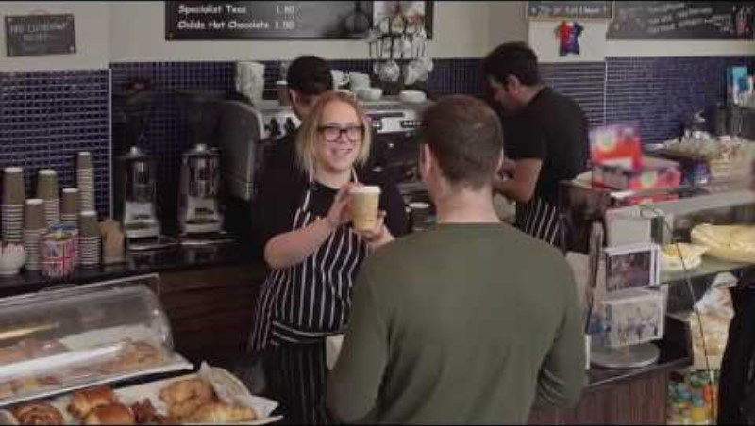
Staying safe online from criminals
#ScamAware
www.friendsagainstscams.org.uk
Notes:
Here is a video which shows how easy it is for someone to find out personal information about you from your social media account. Make sure to always have your accounts set to ‘private’ and do not share any personal information online such as your address or bank details

Slide 16

Phishing
Phishing is a way that criminals get access to info like your usernames and passwords.
This is usually done by an urgent email which will take you to a fake website which may look real or familiar to you.
They are fake sites set up by criminals to gain your personal details.
#ScamAware
www.friendsagainstscams.org.uk
Notes:
Don’t click on any links that you feel are unsafe or from a person you do not recognise.

Slide 17

Phishing
Phishing can also happen by phone via text messages known as smishing or by a call which is called vishing.
#ScamAware
www.friendsagainstscams.org.uk
Notes:
Don’t click on any links that you feel are unsafe or from a person you do not recognise

Slide 18

Gaming
Games that contain virtual money such as Fortnite have enabled criminals to take money from young people.
There are many websites that are offering free virtual money for different games, provided you pass on your personal details.
This could result in criminals having access to yours or your parent’s bank accounts.
#ScamAware
www.friendsagainstscams.org.uk

Slide 19
Gaming
As games are being turned into mobile versions, criminals have started to create fake downloadable versions of the game.
This is another way to get you to give your personal data to criminals.
#ScamAware
www.friendsagainstscams.org.uk

Slide 20
Financial Exploitation
Financial exploitation is abuse. It can take many forms, using different types of money including crypto. It might seem harmless, but is often linked to fraud, and it can be dangerous.
#ScamAware
www.friendsagainstscams.org.uk

Slide 21
Financial Exploitation
Young people are being encouraged or forced to:
Open a bank account for some else to use
Accept money (from crime) into their account to transfer to someone else (money laundering)
Let someone else use the bank card to buy things which they plan to fraudulently return (a type of fraud).
#ScamAware
www.friendsagainstscams.org.uk

Slide 22
Financial Exploitation
People can be approached:
Using messages or fake job adverts online, including apps, social media, and gaming
At cashpoints or in places like school, college or university
Or by family, friends, boyfriends, girlfriends or partners.
#ScamAware
www.friendsagainstscams.org.uk

Slide 23









Level Up Your Money Game
The chances of being a victim:
It is never too young to start learning how to be sensible and safe with your money.
Research tells us that the less you know about money matters, the more chance you have of being scammed
Speak to people you trust about your money and how it works. Bank accounts, bank cards, savings, subscriptions and so much more…
The more you know about money
100%
90%
80%
70%
60%
50%
40%
30%
20%
10%
0%
0% 10% 20% 30% 40% 50% 60% 70% 80% 90% 100%
The chances of being scammed
#ScamAware
www.friendsagainstscams.org.uk
Notes:
(CLICK) It is never too young to start learning how to be sensible and safe with your money.
(CLICK) A report published by the National Trading Standards Scams Team showed that only 40% of British people identify as ‘financially literate’. This means that they are significantly more likely to have had money stolen due to fraud in the past year. This means that the less knowledge you have on staying safe with your money, the more likely you are to become a victim of scams.
(CLICK) If you have your own bank account, talk to a trusted adult to make sure you can stay safe whilst you earn pocket money, and in the future when you start working and earning

Slide 24

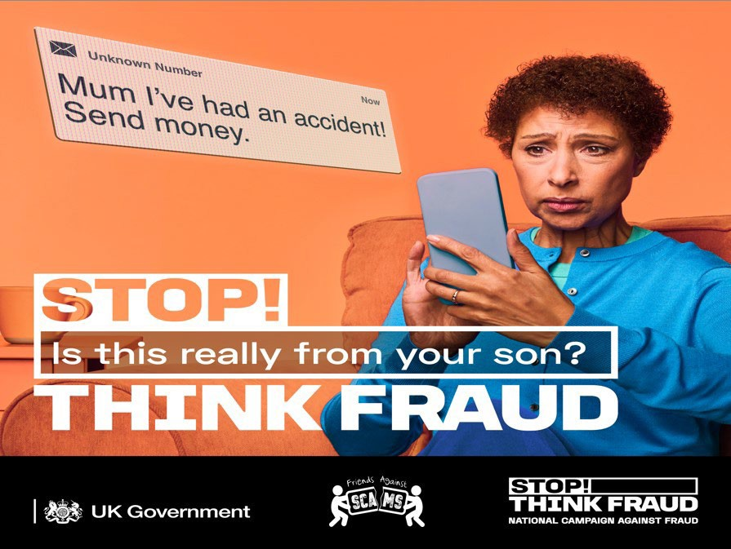
#ScamAware
www.friendsagainstscams.org.uk
Notes:
Info about Stop! Think Fraud Campaign
Left side scam affects young people, right side scam impersonates young people, tell them to warn their families about these impersonation messages

Slide 25





Have you seen a scam aimed at adults?
#ScamAware
www.friendsagainstscams.org.uk
Notes:
Ask the students for hands if think they have seen a scam aimed for adults.
Stress the importance of recognising scams to help their family members (grandparents/parents/aunts/uncles etc)

Slide 26
Postal Scams – the signs
First name used
Requests money for a prize
Stamps used
Looks authentic
#ScamAware
www.friendsagainstscams.org.uk
Notes:
Give a brief recap on postal scams and what they are. This information is available in the Young Friends Background Information document.
Ask the students about what could be a sign of a scam on a letter. Think about things like – making offers that sound unrealistic, giving deadlines to try and rush people into responding.

Slide 27
Online/email scams – the signs
#ScamAware
www.friendsagainstscams.org.uk
Notes:
Give a brief recap on online scams and what they are. This information is available in the Young Friends Background Information document.
Ask the students about what could be a sign of a scam online or sent via email. Think about things like – links that you are asked to click, request for password information, pressure to respond. Click to the next slide to open the laptop animation

Slide 28



Online/email scams – the signs
Incorrect email address Bad spelling
Pressure to respond _{Requests for bank}
info and
No signature
No first name used
passwords
#ScamAware
www.friendsagainstscams.org.uk
Notes:
Give a brief recap on online scams and what they are. This information is available in the Young Friends Background Information document.
Ask the students about what could be a sign of a scam online or sent via email. Think about things like – links that you are asked to click, request for password information, pressure to respond.

Slide 29





Where do you think we should report these scams to?
#ScamAware www.friendsagainstscams.org.uk
Notes:
Listen for replies such as: banks, police

Slide 30






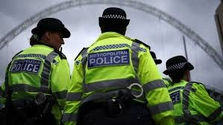

Where to report scams to:
Notes:
Show them the images, tell them about always reporting to their bank if they have had money stolen, and going to the police or sites such as Report Fraud or Citizens Advice. Remind them that Law Enforcement are always working hard on keeping them and their loved ones safe
If you're under 19, you can confidentially call, chat online, or email Childline about any problem, big or small. Call them on 0800 1111.
Youth Access provides information about local counselling and advice services for young people aged 11 to 25 at www.youthaccess.org.uk.
Victim Support offers support to anyone affected by crime; not only those who experience it directly, but also their friends, family and any other people involved. Call them for free on 08 08 16 89 111.

Slide 31
Have a think…
Presenter Notes
2025-12-04 13:39:19
--------------------------------------------
With this question, you could ask for a show of hands for each answer.
Make it clear that this is problem with how people treat scam victims, emphasise the need to stop victim blaming, and that the criminals make the victims scared to tell anyone
How many people who are targeted by scams didn’t even tell the bank or police?
1 thousand
1 million
14 million

Slide 32




What can you remember?
#ScamAware www.friendsagainstscams.org.uk
Notes:
The work undertake on this slide will depend on the time you have available. You can just talk to the students about some of the key messages they have learnt today.
Depending on the time you have available, then you may wish to make use of the games and activities in our files.
NB – Please note that when you move on to the next slide, a short film with music will play automatically, so only move on when you are ready to complete the session
Before moving on to the final slide, you may wish to thank everyone for listening and participating in the session. Explain that you are now going to show them some final slides explaining how they can spread the word about scams and make a promise to share the friends messages with other people.

Slide 33

Congratulations
You are now a Young Friend Against Scams.

Slide 34
What's next?

Slide 35
Make a promise and turn your knowledge into action.

Slide 36
Some example promises to get you thinking about what you can do.

Slide 37
1. Tell five people about scams and
the Friends Against Scams idea.

Slide 38
2. Encourage someone you know to
visit the Friends Against Scams website.

Slide 39
3. Look out for other people. Talk to your friends, your family,
your neighbours about scams!

Slide 40
4. Could you write to your local Member of
Parliament asking them to promote scams awareness?

Slide 41
How will YOU spread the word?

Slide 42
Thank you for joining us today
www.FriendsAgainstScams.org.uk
#ScamAware www.friendsagainstscams.org.uk

