Slide 1

Notes:
Students Against Scams has been set up by the National Trading Standards Scams Team with support from Scam Wise, to help students learn how to protect themselves from scams and fraud.

Slide 2
About Students Against Scams
Raising students’ awareness about the dangers of becoming a money mule
Notes:
The initial focus of Students Against Scams is the issue of money mules and helping to ensure that students are not committing this crime.

Slide 3


Fraud and money laundering
Notes:
Ask students what they understand from the terms - ‘fraud’ and ‘money laundering’.
Do they consider both phrases to relate to criminal activity?
Further details about both terms are on the following pages.

Slide 4
Fraud
Fraud is a criminal offence as defined by the Fraud Act 2006.
Most commonly it occurs when a person dishonestly makes a false representation to gain for themselves or cause loss to another.
Notes:
Discuss the concept of fraud on this slide and the fact that is a serious criminal offence.
Students are likely to recognise that fraud is a serious crime.

Slide 5
Money laundering
Money laundering is where proceeds of crime, such as illegally obtained funds and property, are moved by criminals to make them appear legitimate.
These proceeds can come from crimes such as modern slavery, drug trafficking and fraud.
Notes:
Discuss the concept of money laundering on this slide and the fact that is a serious criminal offence.
Explain to students that money laundering is used by criminals to move around the proceeds of crime from serious offences such as modern slavery, drug trafficking and fraud.

Slide 6
What is a money mule?
Notes:
Ask students what they think a ‘money mule’ is?
Further details about both terms are on the following pages.

Slide 7
Money mules
‘Money mule’ is the term used to refer to an individual, that moves the proceeds of crime on behalf of criminals, sometimes in exchange for payment or other benefit.
Notes:
Discuss the concept of money mules on this slide – pointing out to students that you can be a money mule and move the proceeds of crime without realising.
Important to realise that money mules will be offered a payment or some other benefit, and this is what should make them suspicious.

Slide 8
Role of a money mule
Money mules help hide the origin of illicit funds in various ways, including:
- moving them through their own bank account
- withdrawing cash and handing it over
- buying and selling cryptocurrency
Notes:
Discuss the role of a money mules.
Explain that they are used to hide money from the proceeds of a crimes. Money mules, therefore, play a part in concealing criminal offences.

Slide 9
Role of a money mule
Money mules can also give control of their accounts to criminals to enable them to transfer the funds themselves.
Each transaction helps to further hide the trail of the funds and ultimately to launder the funds.
Notes:
Make the links between money mules and money laundering/fraud that were discussed earlier.
Money mules are money launders – even if they are not aware of it!

Slide 10
Why is learning about money mules so important ?
Notes:
Ask the students why they think learning about money mules is so important?
Next is a short video about the problem with becoming a money mule.

Slide 11
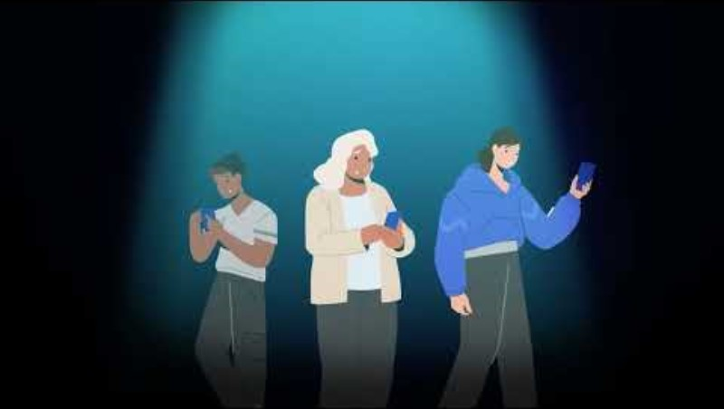
Notes:
Video at - https://youtu.be/YpFxmzLGMeo

Slide 12
Crucial link to fraud
Money mules are a crucial link in the fraud chain –they are criminals in the eyes of the law, but many are completely unaware of their involvement. You may know one or even be one yourself!
Mule accounts are used to move around £10bn per year of fraudulently obtained cash in the UK, according to the National Crime Agency (NCA).
Notes:
Talk about the fact that money mules are a crucial link in the criminal/fraud chain.
Money mules are involved in moving £10 billion – they are committing a serious criminal offence.

Slide 13
Why and how are students targeted?
Notes:
Ask students to think about why they might be targeted?
Can they think of ways that they might be targeted?

Slide 14
Students are often targeted
Students pose a great opportunity for fraudsters, as they’re often short of cash. Many students are also away from home for the first time and have taken control of their own finances
International students who may only be using a UK bank account for a limited time may be encouraged to ‘sell their account’ on at the end of their studies.
Notes:
The main reason that students are targeted is that they are often looking for ways to earn additional money.
Students are also in control of their own finances, often without parental oversight, making it less likely for these criminals to get caught out.

Slide 15
Techniques used by criminals
Criminals are experts at using befriending and grooming techniques to lure their victims.
They start like this
and quickly move to this
Appearing legitimate
Helpful
Persuasive
Persistent
Friendly
Charming
Threatening
Aggressive
Intimidating
Notes:
It is important for students to remember that money mule recruiters are criminals. These criminals have developed a range of befriending techniques, which are designed to persuade people into joining them.
The techniques on this slide are used for many frauds and scams. Sadly, once someone has been recruited – the nice, helpful friend they think they have made will turn into someone that is controlling and aggressive, often making that person feel scared and trapped.

Slide 16
Recruiting students
There are many ways that criminal organisations recruit students to become money mules.
You could be directly approached by another student or contacted online.
Notes:
It is important for students to understand that there are a number of different ways that they could be approached by a money mule recruiter. This could be face to face or online.
The following are examples – this is not an exhaustive list. Criminals keep changing their methods, so students need to ensure they stay alert at all times.

Slide 17
Four main recruitment methods
Job
scams
Romance scams
Fake websites
Investment scams
Notes:
The next few slides will discuss some of the key methods – remind students that this is NOT an exhaustive list.
Ask students whether anyone has been approached using any of these methods.

Slide 18
Job scams
Money mule recruiters contact you via email, WhatsApp or a social media platform about a new job without you having applied for a position or to the company.
The ‘employer’ doesn’t provide any details about their company but asks you to work for them.
Notes:
Discuss the content of this slide.

Slide 19
Romance scams
Money mule recruiters pose as romantic interests online, via social media or a dating platform.
After developing the ‘relationship’ they ask you to set up a bank account or move money for them.
Notes:
Discuss the content of this slide.

Slide 20
Fake websites
Money mule recruiters set up fake websites offering you a quick and easy way to make money.
If you respond you are put in touch with someone and their job is to recruit you as a money mule.
Notes:
Discuss the content of this slide.

Slide 21
Investment scams
Money mule recruiters send messages offering big returns on small investments quickly and easily.
They will give examples of how quickly you can ‘grow’ your money. Any interest in the investment is used as a way to recruit you.
Notes:
Discuss the content of this slide.

Slide 22
Consequences of being a money mule
Notes:
Ask students how severe they think the consequences are if they become a money mule.
Do they think these consequences are less severe if they did not realise or if they did not know what they were doing?

Slide 23
Severe consequences
Becoming a money mule will lead to severe and life changing consequences, regardless of your intention to defraud others.
Notes:
Explain that becoming a money mule can lead to severe and life changing consequences – this is regardless of whether you were aware that you were carrying out fraudulent or criminal activity.

Slide 24
Life changing consequences
Criminal record and up to 14 years in prison
Closure of bank accounts
Permanent damage to your credit history
Difficulty securing loans, mortgages or even renting a property
Notes:
Run through the examples given above – highlighting the fact that these are long-term consequences, which are likely to affect the rest of their lives.

Slide 25
Signs someone might be a money mule
Notes:
It is important for students to learn how to protect themselves and to keep an eye on their friends.

Slide 26
Keep an eye on your friends
It is also important to watch your friends to make sure they are not being drawn into the criminal web of money mules.
You can look out for the following signs in others:
Notes:
Even if a friend does not confide in you, there are signs that you can look out for which might indicate they may have been recruited to become a money mule.

Slide 27
Look for these signs
Having extra cash with little explanation as to how they got the money
Having a ‘vague’ new job or money-making scheme
Talking more about someone new they have met online
Being secretive
Becoming more stressed and anxious
Notes:
Discuss these signs – has anyone ever spotted any of these signs with one of their friends?

Slide 28
Getting help
Stop contact – if you or someone you know has become a victim, break contact and don’t move any more money.
Trusted adult - if you are worried that you have been targeted as part of this crime, you should speak to another adult that you trust.
Bank – contact your bank as soon as possible, they may have a specialist team that will be able to help you.
Report – you can report concerns about money mule recruiters to local Police on 101 or 999 in an emergency.
Notes:
Discuss the importance of getting help and support. Whether it is you or a friend that has become a money mule – it is important to know that help is available.
It is more damaging for someone to just ignore the issue and hope that it goes away on its own. Once criminals have recruited you, they are highly unlikely to stop. They will just keep coming back to you asking you to launder more money or commit other crimes.
Remember - The quicker you can get help and support the better.

Slide 29
Students Against Scams
Don’t pay the PRICE by letting criminals steal your future
Notes:
Remind students that it is their future – it is important they don’t let criminals steal that from them.

Slide 30
Remember
Protect – take steps to protect yourself and your friends
Risks – think about all the risks for your future
Identity – recruiters will often use a fake identity
Crime – money mules are committing a crime
Educate – learn about the dangers of becoming a money mule
Notes:
Don’t pay the PRICE by letting criminals steal your future. Remember PRICE –
Protect
Risks
Identity
Crime
Educate

Slide 31


Students Against Scams
Supported by

