Slide 1



Young Friends Against Scams – Romance Fraud
Notes:
Introduce yourself.
Explain to the students that you are going to talk to them about romance fraud and how to protect themselves online
Let them know that this is going to be quite interactive so encourage them to please take part.

Slide 2
Learning Objectives:
You will learn what Romance Fraud is
You will learn what tactics criminals use to get close to their victims
See some examples of these tactics that the criminals use
You will learn how to stay safe when using online platforms
Notes:
Read out the learning objectives.

Slide 3
Let’s talk. What is Romance Fraud?
Notes:
Ask them to see if they know what it is, correct answer is criminals stealing money by pretending to enter an online relationship with the victim

Slide 4


Let's think…
How much money was reported stolen through romance fraud in the UK last year?
More than
£100,000,000
Less than
£100,000,000
More than
£100,000,000
Report Fraud reported that over £100,000,000 was stolen last year through romance fraud (£106,000,000)
Notes:
Ask for a show of hands for whether the students think more or less than £100 million was stolen last year

Slide 5
Tactics criminals use:
Fake images/catfishing
‘Sob story’
Isolating victims
Love bombing
Unusual payment methods
Creating long-distance scenarios
Notes:
Here are a few of the most common tactics these criminals might use. We will go through each one in more detail soon:
Fake images/catfishing
Creating long distance scenarios
Creating a fake sad story about their lives
Isolating their victims from loved ones
Love bombing their victims
Asking for payment in unusual forms, not in bank transfers
Ask the students if they have any thoughts on why the criminals might use these tactics, or what some of them may mean

Slide 6

Fake images/Catfishing:
Catfishing – pretending to be someone you’re not online, using stolen images, typically to steal money from a victim
The criminals may pose as somebody your age to get close with you, before starting to implement some of the other tactics we will look at
Notes:
Catfishing is when a criminal pretends to be someone they are not online, using stolen images, typically to steal money from a victim. In this case the criminals may pretend to be somebody your age to get close with you, before starting to implement some of the other tactics we will look at.

Slide 7

Creating long distance scenarios:
Criminals will often ask where their victim is from, and use this information to pretend to be somewhere far away from that
They do this to make sure the relationship can stay online to keep up their fake persona
Notes:
Criminals will often ask where their victim is from and use this information to pretend to be somewhere far away from that, to avoid the risk for them of the victim asking to meet in person. The scam only works if the communications are kept online.
They do this to make sure the relationship can stay online to keep up their fake persona until they gain trust (using tactics we will look at next)

Slide 8

Creating a ‘sob-story’:
Sob Story: A false story about their life to make the victim feel sorry for them
A common example of this may be having an ill relative that they need to borrow money for their surgery
They pretend to be vulnerable early on to
gain the victim's trust
Notes:
Criminals will often create a sad story about their character’s life to guilt the victim into staying, and often use this story to steal money later down the line
A common example of this may be having an ill relative that they need to borrow money for their surgery
They pretend to be vulnerable early on to gain the victim's trust

Slide 9

Isolating victims:
Criminals will often try to isolate their victims from their loved ones
This isolation means they can steal money from their victims later, as the victims will not ask their
friends/family about it
Notes:
Criminals will often try to isolate their victims from their loved ones, usually by guilt-tripping them into not ignoring the messages they are sending
This isolation means they can steal money from their victims later, as the victims will not ask their friends/family about it

Slide 10

Love-bombing:
Criminals often overwhelm their victim with affection and a lot of attention very early on
Some examples of this are:
  Constant contact
  Disregard for boundaries
  Intense emotional neediness
Notes:
Criminals will often use a tactic called ‘love-bombing’, which means they overwhelm their victim with affection and a lot of attention very early on.
Some examples of this are:
Constant contact – then making the other person feel guilty for not answering quickly
Disregard for boundaries – disguising this by claiming they are in love
Intense emotional neediness – making the victim feel like they are responsible for the criminals emotions to keep them talking

Slide 11

Unusual payment methods:
Criminals will often ask for payments in forms that are less traceable when they finally do ask for money
To stay safe, never give or lend money to someone you do not know in real life, as you do not know who
is on the other end of the message
Notes:
Criminals will often ask for payments in forms that are less traceable, like gift cards/cryptocurrency etc rather than bank transfers
To stay safe, never give or lend money to someone you do not know in real life, as you do not know who is on the other end of the message

Slide 12
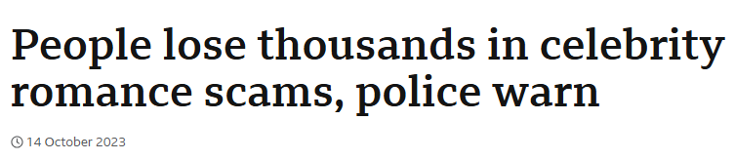
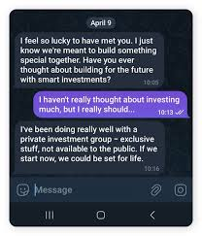
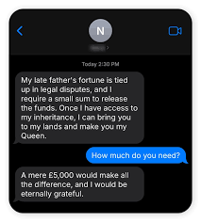
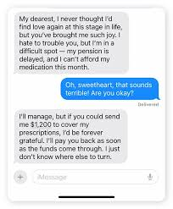

Some examples:
Notes:
Here are some examples of romance fraud:
People lose thousands: evidence of the sheer amount of money a victim can have stolen
The Tinder Swindler: A Netflix documentary about a group of women who were victims of romance fraud, the criminal at fault had stolen over $10 million (£7.5 million)
Text image 1: Example of a sob story to steal money (pension delayed)
Text image 2: Example of love bombing
Text image 3: Example of long distance + sob story

Slide 13
Some Stats:
In terms of the total length of these frauds:
  48% of victims communicated with the suspect for 1-6 months
  16% for 1-3 years and 11% for longer than 3 years
  5% of those targeted were in communication with the criminal for more than 6 years.
Notes:
Here are some stats that show how much romance fraud affects people:
This gives an indication of the cruel, intense, sustained nature of this kind of offending.
Read the stats off the slide

Slide 14
Let's look at some scenarios…

Slide 15
Scenario 1:
You receive an Instagram message from someone who’s profile picture appears to be someone your age, asking if you want to chat with them. They ask where you are from, and then say they are from the USA but still want to talk. Once you start messaging, they message you increasingly often and get upset with you when you take longer to respond.
What tactic is the criminal using:
A: Long distance scenarios
B: Love bombing
C: Fake images/catfishing
D: All of the above
Notes:
Read out the scenario and ask for a show of hands for each answer
Correct answer is D

Slide 16
Answer
D: All of the above

Slide 17
Scenario 2:
You receive a WhatsApp message from someone whose profile picture appears to be someone your age, and they quickly express strong interest in getting to know you. They ask a few basic questions and almost immediately begin showering you with compliments, affectionate language, and talk about a special connection. They quickly escalate by sending constant messages, expressing intense feelings very early, and suggest exclusivity or a future together very soon.
What tactic is the criminal using:
A: Unusual payment methods
B: Love Bombing
C: Creating a sob story
Notes:
Read out the scenario and ask for a show of hands for each answer
Correct answer is B

Slide 18
Answer
B: Love Bombing

Slide 19
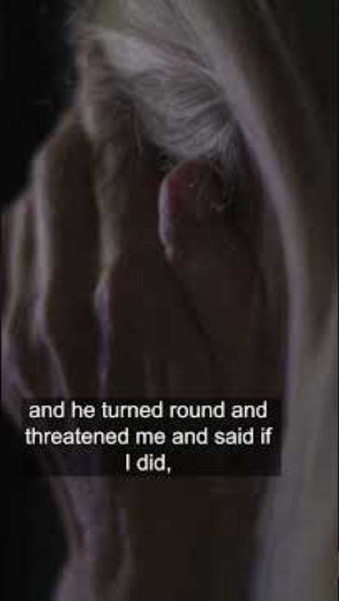
Video
Notes:
Here we have a short video which shows the effects of romance fraud on a victim

Slide 20
So how can you stay safe?
Notes:
Ask the students for any suggestions

Slide 21
How can we stay safe when talking online?
Below are some tips on how to stay safe in this situation:
  Use reverse image search
  Keep communication only on the platform they messaged on first
  Always protect your personal information, keep social media accounts private
  Never send money to someone you have not met
  Never send any images of yourself to someone you have not met
Notes:
Below are some tips on how to stay safe in this situation:
Use reverse image search – useful to stop catfishing
Keep communication only on the platform they messaged on first – criminals will often ask to talk on a different app very soon into your conversation and sometimes these apps allow the criminal to find out information about you, always stay on well known, trusted apps
Always protect your personal information, keep social media accounts private – only allow people you know in real life to follow your accounts, and never reply to suspicious messages
Never send money to someone you have not met – you never know who is actually on the other side of the messages
Never send any images of yourself to someone you have not met - you never know who is actually on the other side of the messages

Slide 22
How can we help a friend or family member who is a victim?
Here are some tips on how to support them:
  Encourage open conversation
  Be calm and considerate of their feelings
  Help secure their financial accounts if they have sent any money
  Remember to not blame the victim
Notes:
Here are some tips on how to support them:
Encourage open conversation – they may be defensive or in denial about it, so make sure to approach the conversation in a considerate way
Be calm and considerate of their feelings
Help secure their financial accounts if they have sent any money – contact their banks/tell a responsible adult to contact their banks for them so the accounts can be monitored properly
Remember to not blame the victim, use language to place the blame on the criminals instead!

Slide 23
Where to Report:
Your Bank
The Police
You can go to Report Fraud here: UK's Home for Reporting Cyber Crime & Fraud - Report Fraud or by calling 0300 123 2040
You can report anonymously via the Crimestoppers website or by calling 0800 555 111.
Notes:
Read the slide

Slide 24
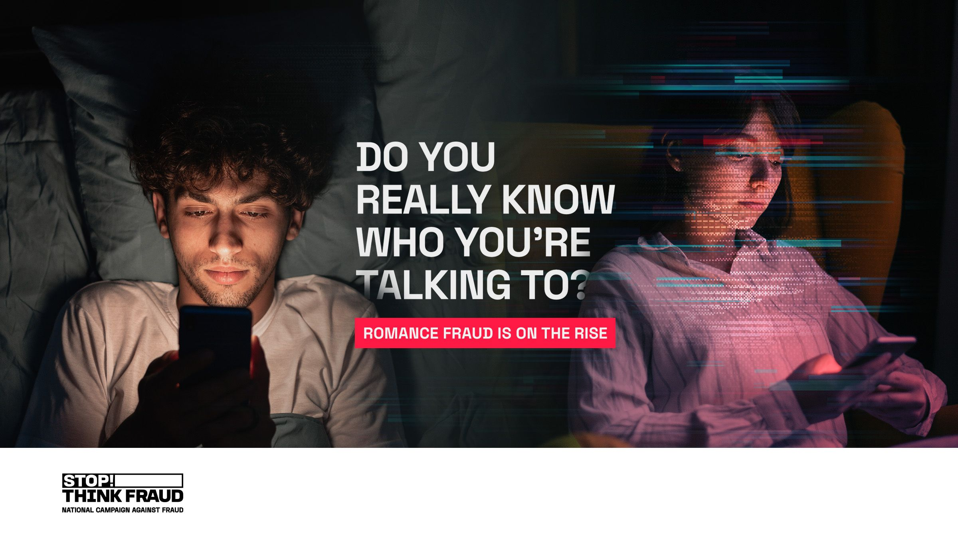
Notes:
Always remember, you never know for sure who you are speaking with so take the steps discussed today to stay safe online

Slide 25
Thank you for attending
Please remember:
If you have responded to a scam, it isn’t your fault.
Anyone can be a scam victim.
Support your friends if they have responded.
Notes:
Thank you for attending today’s assembly.
Some thoughts to leave on:
Please remember that if you have responded to a scam it isn’t your fault. Criminals are sophisticated and you shouldn’t blame yourself. There is a scam out there for everyone.
Anyone can be a scam victim
Support your friends if they have become victims.
Show of hands who knows now what they are going to do different going forward. Pick a couple of volunteers.
If time at the end, ask if any of the students or teachers have any questions.
END

