Slide 1

Comments from the team
This social media pack has been designed to promote the free Friends Against Scams App to be used by supporters, organisations, partners, and Friends Against Scams directly.
Each of the following pages will have suggested text for a social media post and an accompanying infographic/image.

Slide 2
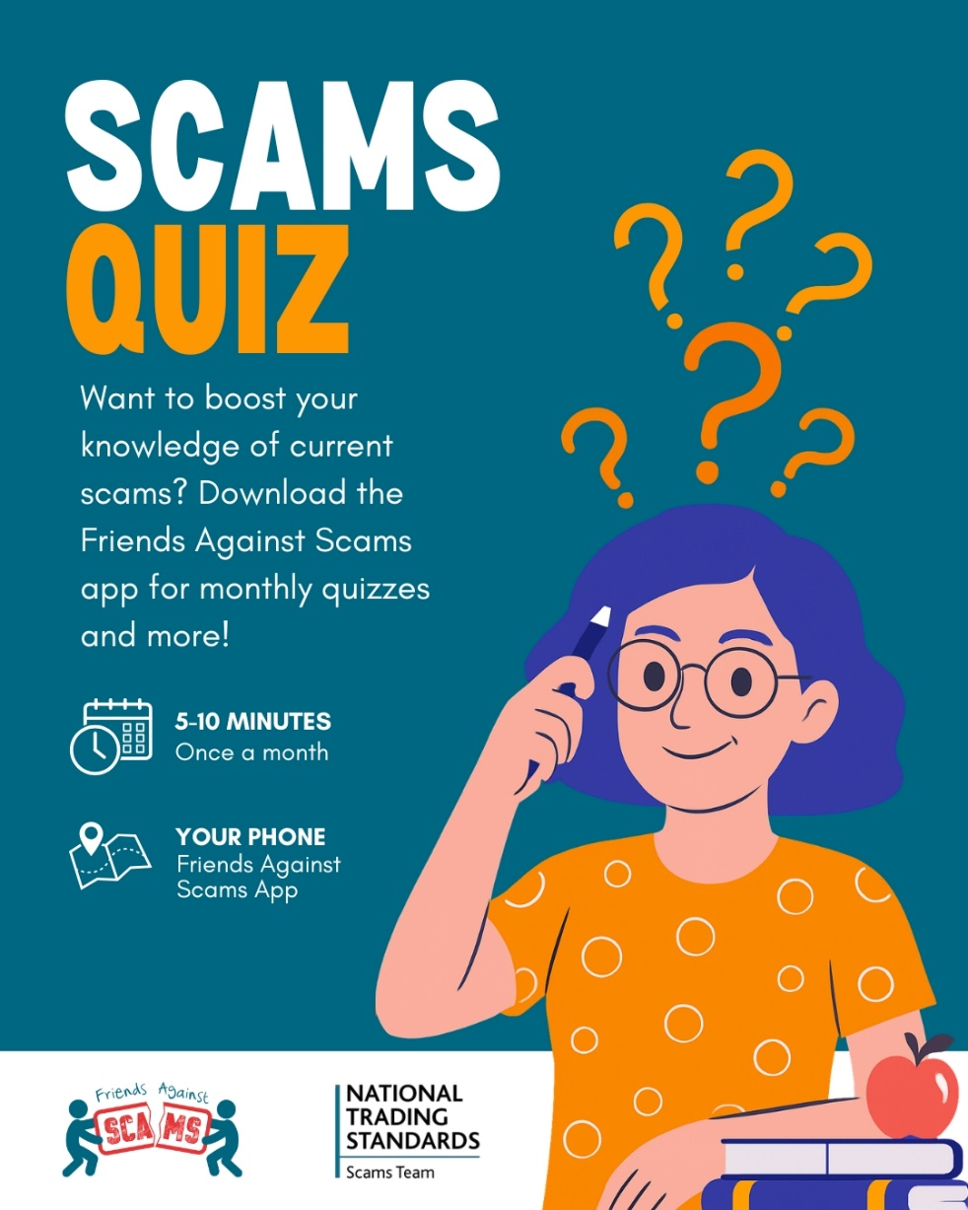

Suggested text:
Think you can spot a scam? 🕵️‍♀️
Test your knowledge with the monthly Scams Quiz in the Friends Against Scams app.
It only takes 5-10 minutes and helps you stay one step ahead of the latest fraud and scams.
Download now on the App Store and Google Play.
https://linktr.ee/Friends_Against_Scams
#friendsagainstscams #scamaware

Slide 3
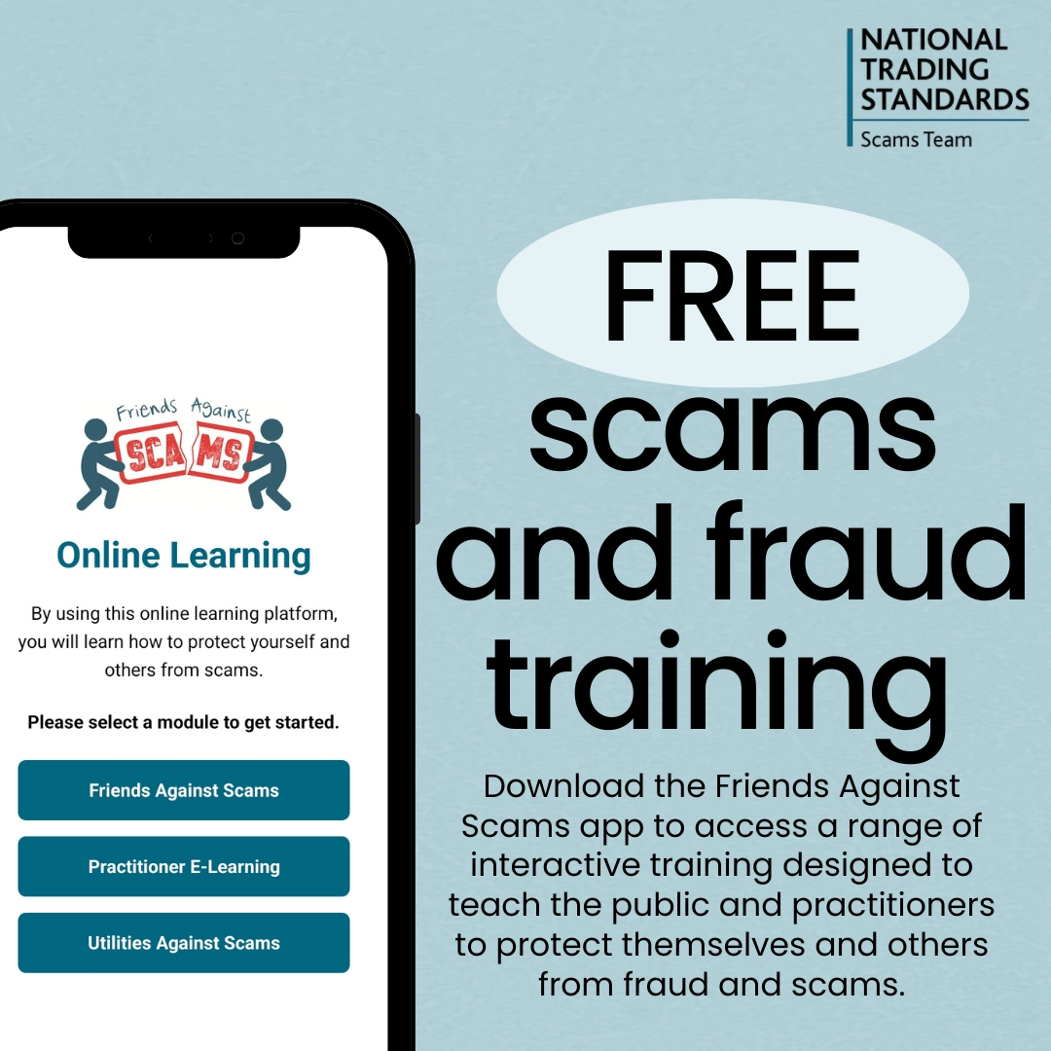
Suggested text:
Learn how to spot and stay safe from scams.
The Friends Against Scams app offers free, easy-to-follow training to help you protect yourself and others from fraud.
Download the app today on the App Store and Google Play to get started.
https://linktr.ee/Friends_Against_Scams
#friendsagainstscams #scamaware

Slide 4
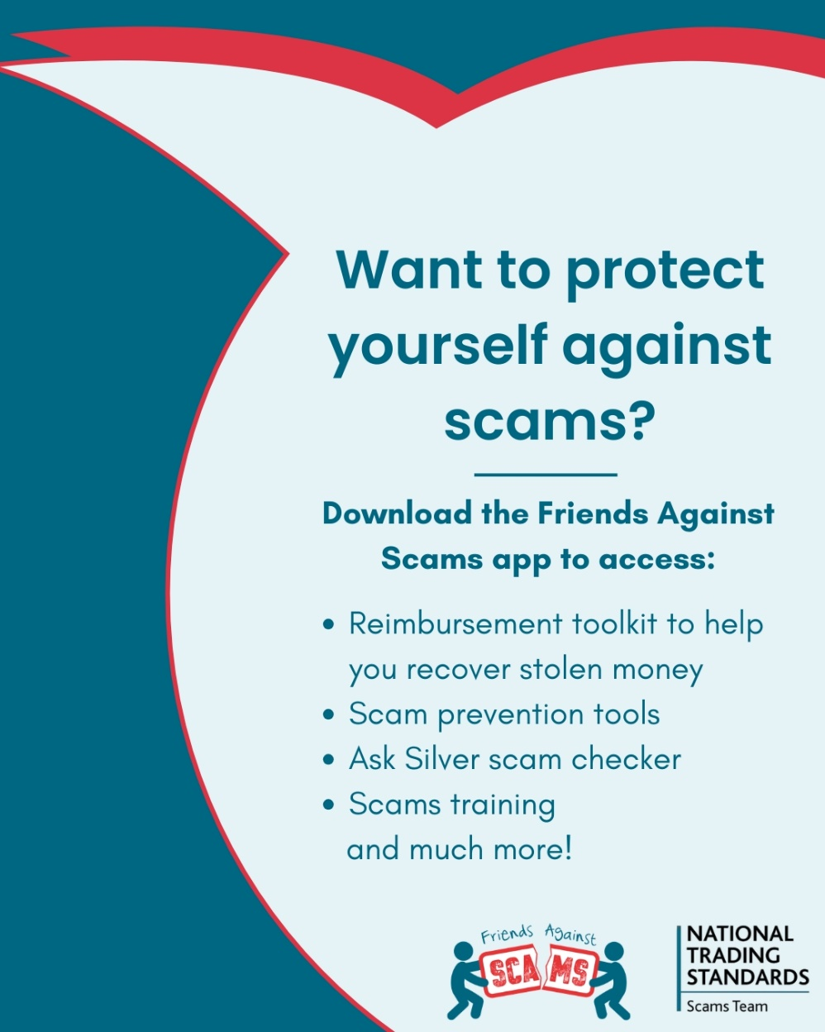
Suggested text:
Want to protect yourself from scams?
Download the Friends Against Scams app to access helpful tools, scam training and support to keep you and others safe. From prevention tips to a scam checker and recovery guidance, all in one place.
https://linktr.ee/Friends_Against_Scams
#friendsagainstscams #scamaware

Slide 5
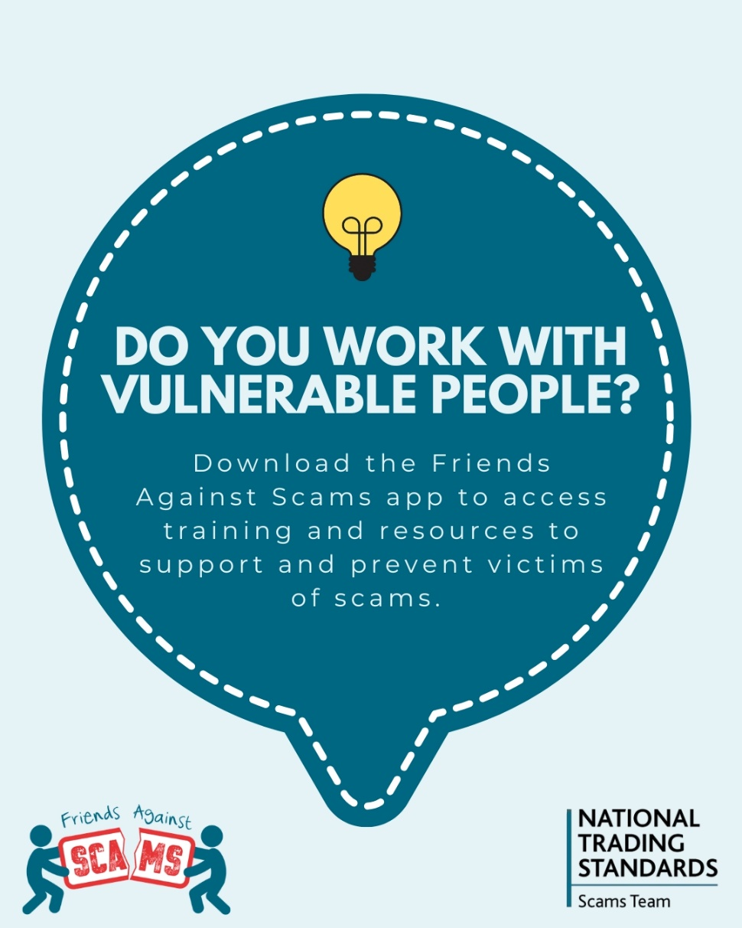
Suggested text:
Work with vulnerable people? Learn how to help them stay safe from fraud and scams. 🤝
Download the Friends Against Scams app to access practical training and resources designed to prevent scams and support those at risk.
https://linktr.ee/Friends_Against_Scams
#friendsagainstscams #scamaware

Slide 6
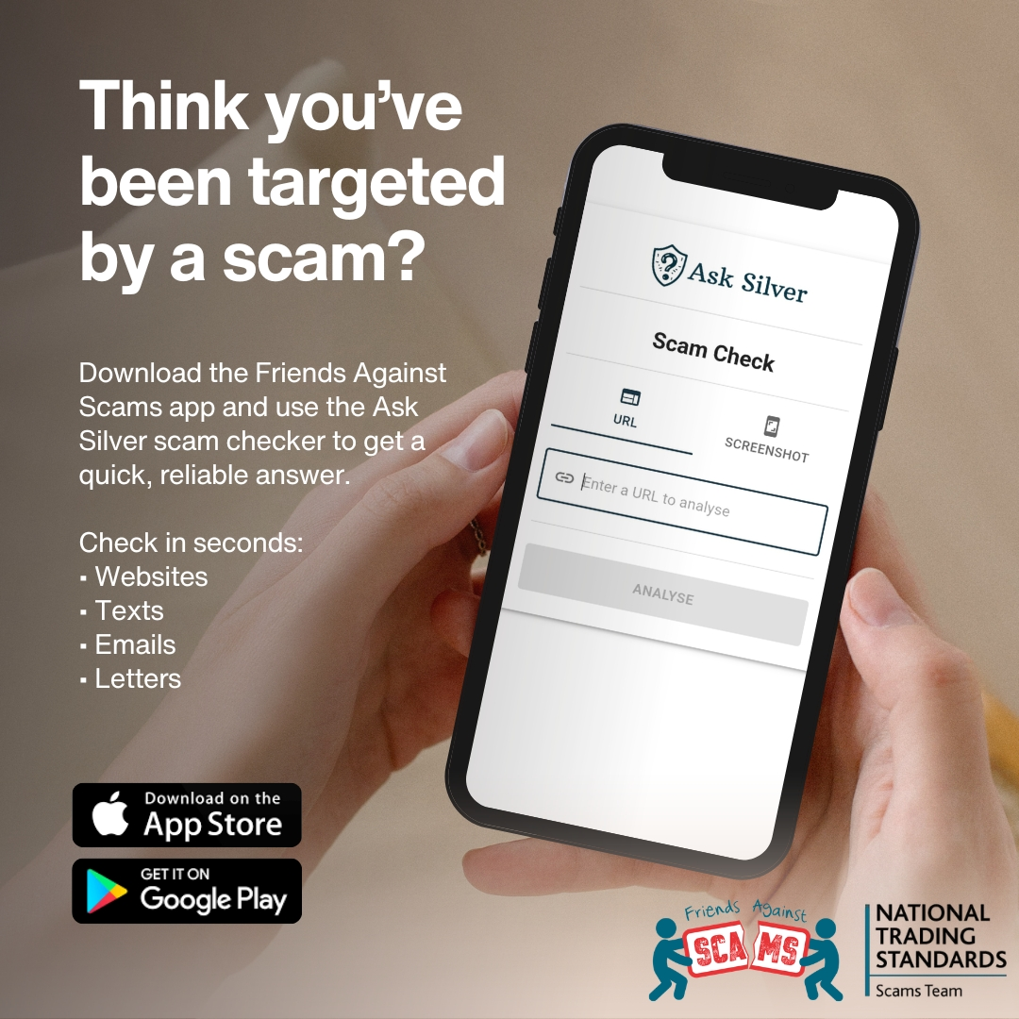
Suggested text:
Think you’ve been targeted by a scam? Don’t guess when you can check. 🔍
Download the Friends Against Scams app and use Ask Silver for a fast, reliable answer. Scan suspicious websites, texts, emails, or letters in seconds and stay one step ahead.
https://linktr.ee/Friends_Against_Scams
#friendsagainstscams #scamaware

Slide 7
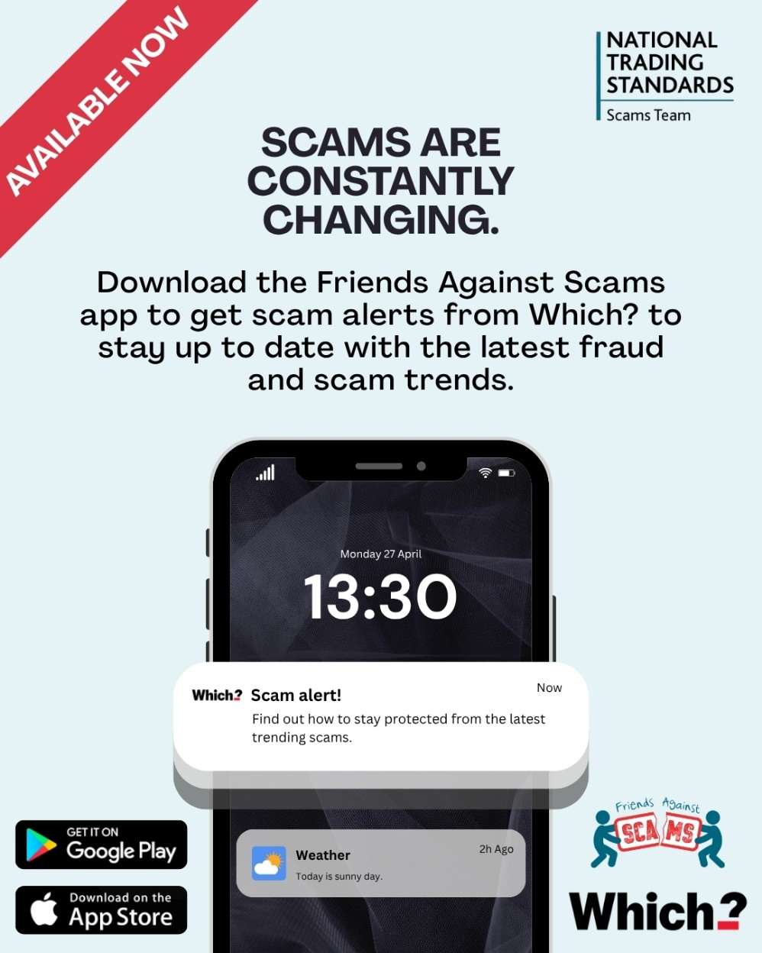
Suggested text:
Criminals are constantly changing their tactics.
Download the Friends Against Scams app to get trusted scam alerts from Which? and stay up to date with the latest fraud and scam trends.
https://linktr.ee/Friends_Against_Scams
#friendsagainstscams #scamaware

Slide 8
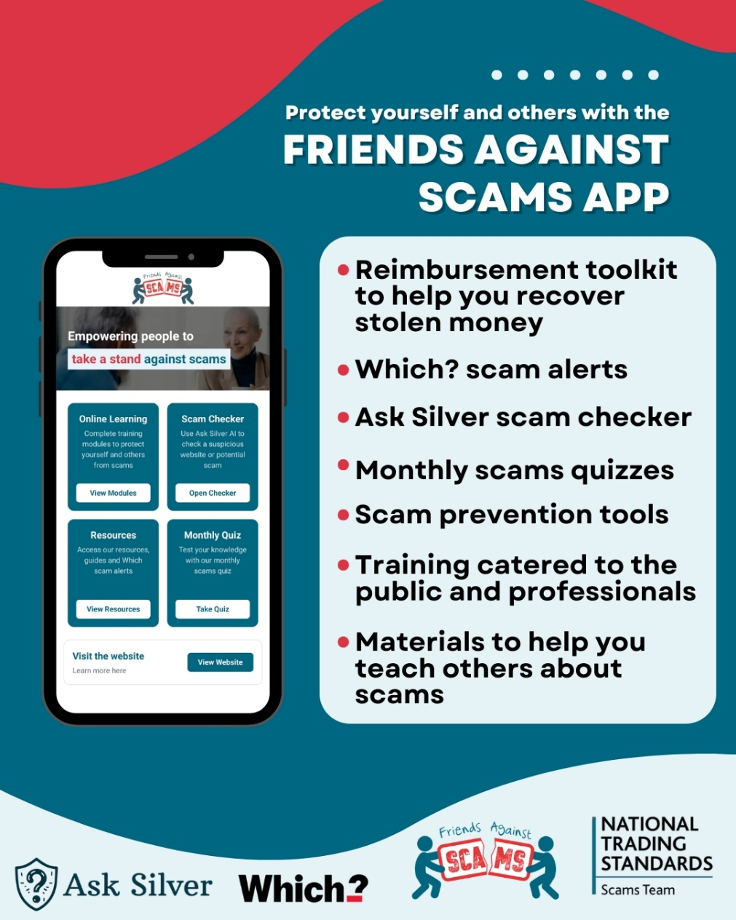
Suggested text:
Anyone can be a victim of fraud and scams.
The Friends Against Scams app gives you more than alerts: recover stolen money with a reimbursement toolkit, check suspicious messages with Ask Silver, access Which? scam alerts, and use ready-made resources to educate others. Plus, quizzes, training, and tools to stay up to date on latest scams.
https://linktr.ee/Friends_Against_Scams
Stay informed. Stay protected.
#friendsagainstscams #scamaware

Slide 9
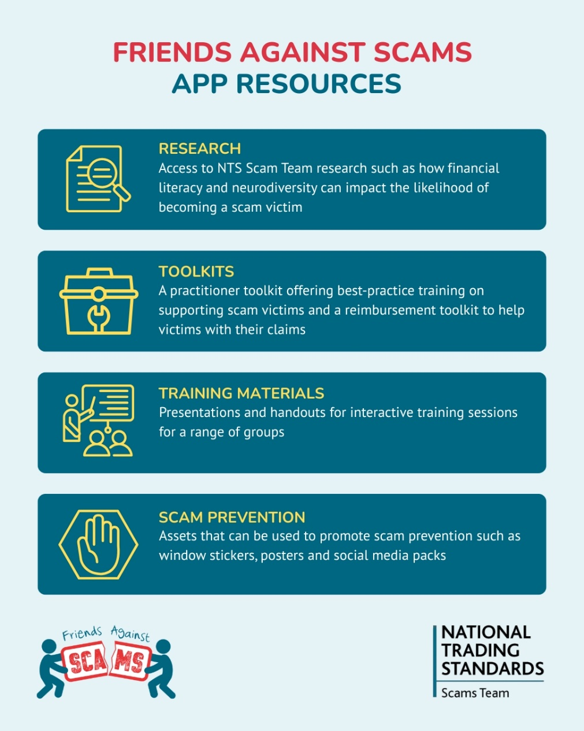
Suggested text:
Want to learn how to protect yourself from fraud and scams?
Download the Friends Against Scams app to access these resources and more!
https://linktr.ee/Friends_Against_Scams
#friendsagainstscams #scamaware

