Slide 1



Young Friends Against Scams
Year 8 - Assembly Session
Scams on social media
Notes:
Introduce yourself.
Explain to the students that you are going to talk to them about scams that target you on social media.
Let them know that this is going to be quite interactive so encourage them to please take part.
click

Slide 2
Learning Objectives:
Understand what scams are and why criminals target young people.
Recognise common scams on social media (fake competitions and giveaways, fake profiles, account hacking links).
Learn how to protect yourself online.
Know what to do if you or a friend respond to a scam.
Notes:
Read out learning objectives
So by the end of this assembly you will all know exactly what to do if you are targeted.
Next.

Slide 3
Hands up if…
You have at least one social media account.
You have ever received a message from someone you don’t know.
You think it might have been a scam.
Notes:
To start off, let them know there are no judgements here, and ask for hands up if…
Announce approx. how many in the room have their hands up after each question.
You have at least one social media account. – say examples like tiktok, snapchat or Instagram.
Keep your hands up if you have ever received a message from someone you don’t know.
Keep them up if you think it might have been a scam.
Let them know that it’s good that they are able to start to recognise them.
Next slide.

Slide 4
What are scams?
A scam is something that has been set up to coerce and manipulate people into giving them the following:
Personal information
Money
Bank details
Passwords
Notes:
What are scams?
Read through slide.

Slide 5
What we mean by “personal information”…
Notes:
We mentioned personal information but here’s what that actually covers.
Click

Slide 6

What we mean by “personal information”…
Full name
Home address
Age
Date of birth
Phone number / email address
Notes:
Read through slide.
These are some of the examples but not all.
It’s really important to know that criminals can use this information to target you with specific scams that they know you may respond to.
If they can’t gain access to your own account, they can also create a new account pretending to be you. The more information they have on you, the easier this is. They can then use this fake account to contact your friends list, followers and even family members with other scams.
CLICK
If dealing with a company, always check they are real before giving away information. AND NEVER give this information to anyone over a direct message.

Slide 7
Criminals set up fake profiles pretending to be…
Notes:
It’s important to know that…
read slide
CLICK

Slide 8





Criminals set up fake profiles pretending to be…
Friends
Family members
Celebrities
Real companies
The Government
Notes:
Read through each example as you click through
This means that a scam can come from anywhere, so we need to be on our guard when something doesn’t feel right.

Slide 9
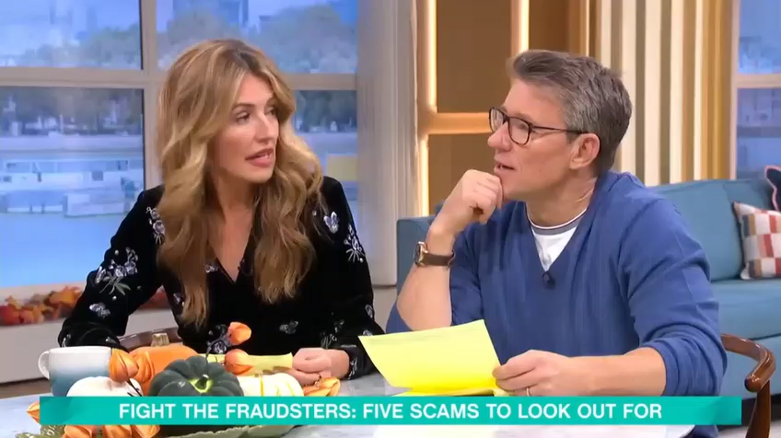
Examples
Notes:
We’re going to watch a really short clip from This Morning which has some good examples of the types of scams you might find on your social media feed.
As we watch, have a think if you’ve ever seen anything like this.
Click

Slide 10
Hands up if you have seen these examples.
Notes:
Have you seen something similar to these examples that were in the video.
Each time, tell the audience an estimate of the amount of hands up

Slide 11
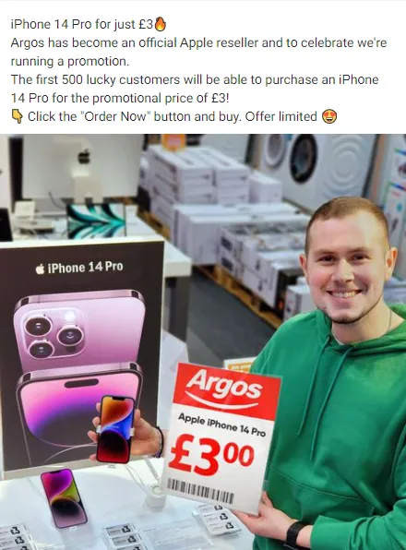
Fake Offers
Notes:
1st example, hands up if you’ve ever seen a fake promotional scam like this one on your feed? Announce approx. amount of hands raised in the room.
This one is from Facebook and is claiming to be a promotion from Argos – offering an iphone 14 pro for £3.
If you click the order now button it will take you to a fake website where they will steal your personal information and bank details, leading to money being stolen.

Slide 12
Fake Offers
Remember:
Never click the link.
Check the official company’s website by searching for it yourself.
Offers like this are unrealistic.
Report it.
Notes:
Things to remember when you see these:
Read out.

Slide 13
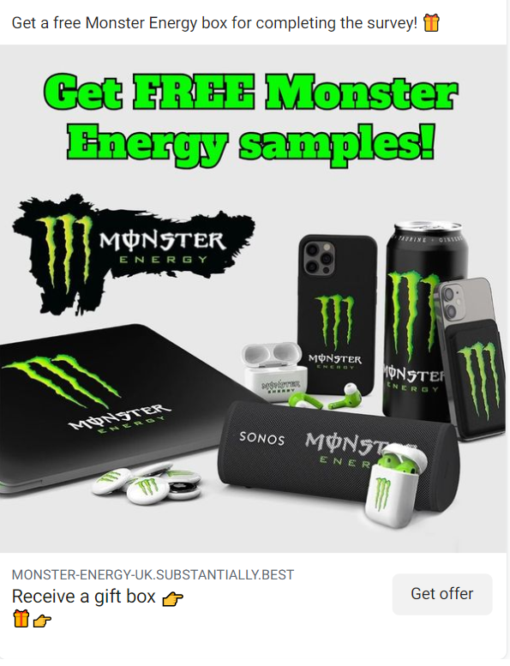
Fake Giveaways
Notes:
Hands up who has seen a fake giveaway scam like this one? This is about Monster Energy in particular but it could be from another company. Announce rough amount of hands to room.
This one is a fake giveaway by completing a survey.
It includes a link to a website which promises a year's supply of Monster Energy products as part of a new promotion.
The survey asks how often you drink energy products and what Monster Energy packaging they prefer, among other questions.
After completing the survey, you’re then asked to hand over personal information in order to receive the 'free products’.

Slide 14
Fake Giveaways
Remember:
Never click the link.
Check the official company’s website by searching for it yourself.
Don’t enter your personal information into surveys.
Report it.
Notes:
Things to remember when you see one of these:
Read the points as they come up.

Slide 15
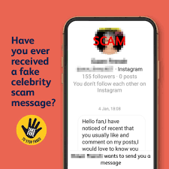
Fake Celebrities
Notes:
Hands up who has ever received a message from an account pretending to be a celebrity? Announce amount of hands to room.
As mentioned criminals will pretend to be celebrities and will target you if they know that you are a fan, this could be as simple as seeing that you follow the real celebrity account.
Usually they will get you to click links that get you to sign in with your account details – this is then stolen.
They might get you to send money for a charitably cause, invest in cryptocurrency, or buy an exclusive meet and greet – all of this is fake.
click

Slide 16
Fake Celebrities
Remember:
Celebrities rarely send friend requests and direct messages to fans.
Look out for strange spellings of their account name.
Avoid accepting friend requests or opening messages from people you don’t know.
Report it.
Notes:
Remember:
Read points as they come up.

Slide 17
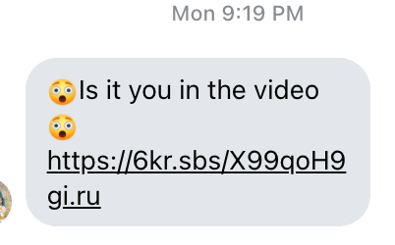
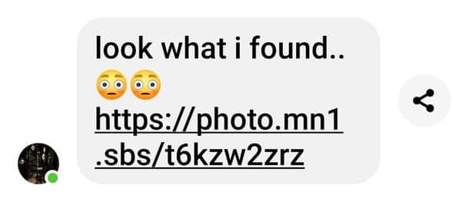
Hacked accounts
Notes:
Hands up who has ever received a text like this from one of your friends out of the blue. Announce approx. amount of hands in the room.
This is a scam where a friend’s account has unfortunately been hacked and the criminal has sent this message out to their friend’s list.
This scam uses manipulation to create a fear of embarrassment when you read it and it preys on the trust you place with your friends.
Once you click the link it will get you to sign into your account which provides the criminals with your login details allowing them to steal your account.
The cycle then continues through your own friends list.
This is just one example however the messages can come in all different forms.

Slide 18
Hacked accounts
Remember:
Don’t click the link.
Ask your friend in real life or through another app if you are unsure.
Never type in your password through a link someone has sent.
Report it.
Notes:
Remember:
Read the points

Slide 19
Scenarios.
Notes:
Now we will look at some scenarios.
Read the questions out to the audience then show all 3 answers, do a hands up for each one. Then show the answer.
Next slide.

Slide 20

Scenarios
You see a post on Instagram from a page claiming: “We’re giving away 50 free iPhones to celebrate our anniversary! Click the link to get yours!” Do you:
Click the link and enter your details
Ignore the account and report it as suspicious
Message the page asking if it’s real before entering your details
Tip: Never ask the page if it’s real, criminals will always say yes.
Notes:
Read question
You see a post on Instagram from a page claiming: “We’re giving away 50 free iPhones to celebrate our anniversary! Click the link to get yours!”” Do you:
Click through answers
Click the link and enter your details
Ignore the account and report it as suspicious
Message the page asking if it’s real before entering your details
Hands up for A, hands for B, hands for C. Show answer.
Read tip
Tip: Never ask the page if it’s real, criminals will always say yes.

Slide 21
Scenarios
Your friend sends you a message with a link to The Ultimate Challenge Game saying “You have try this, it’s so funny”. Do you:
Share with friends so they can play it too
Click the link instantly as it must be safe it it’s from your friend
Ask your friend on another app or in person to see if they really sent it
Tip: If your friend’s account is hacked, the links they send could be literally anything. Be safe and don’t trust any of them.
Notes:
Read question
Your friend sends you a message with a link to The Ultimate Challenge Game Saying “You have try this, it’s so funny”. Do you:
Click through answers
Share with other friends so they can play it too
Click the link instantly as it must be safe it it’s from your friend
Ask your friend on another app or in person to see if they really sent it
Hands up for A, hands for B, hands for C.
Show answer.
Read tip:
Tip: If your friend’s account is hacked, the links they send could be literally anything. Be safe and don’t trust any of them.

Slide 22
Scenarios
You see an advert while scrolling of a shop you’ve not heard of selling a pair of trainers you like at limited stock for £12 which usually go for £120. Do you:
Buy them quickly before the deal ends
Share with your friends
Avoid completely
Tip: This offer has a huge discount of 90% which is unlikely especially if the item is popular. Always stop and think when you see an offer like this.
Notes:
Read question
You see an advert while scrolling of a shop you’ve not heard of selling a pair of trainers you like at limited stock for £12 which usually go for £120. Do you:
Buy them quickly before the deal ends
Share the deal with your friends
Avoid completely
Hands up for A, hands for B, hands for C. Show answer.
Read tip
Tip: This offer has a huge discount of 90% which is unlikely especially if the item is popular. Always stop and think when you see an offer like this.

Slide 23
How to spot scams
When you see an offer online, stop and ask yourself 3 questions:
Is the offer unrealistic? – Free or really low priced items
Is it asking for personal info? – Logins, passwords, bank details
Is it rushing you to respond? – “Act now or miss out!”
If the answer is YES it is almost always a scam.

Slide 24
How to protect yourself from scams.
Notes:
Here’s some changes you can make today to protect yourself from scams on social media.

Slide 25

How to protect yourself
Check your privacy settings.
Use a strong password
Setup 2 Step Verification (2SV)
Notes:
Firstly, check your privacy settings on your social media account, when you create an account it will likely be automatically set to public, by putting yourself as private, criminals won’t be able to see what you post or follow until you accept them.
Use a strong password – bad examples of a strong password are pet names and something easily guessed like “12345” or the word “password”, remember those survey’s we mentioned – they may ask you something like your pet’s name.
2 Step Verification will make it harder for criminals to steal your account if you accidentally give your email and password. It is worth setting this up for every account you have.

Slide 26

How to protect yourself
Stick to official sources
Only buy products from official websites.
Don’t respond to unrealistic product offers received through messages or that appear on your feed.
Notes:
Stick to official sources
Only buy products from official websites.
Don’t respond to unrealistic product offers received through messages or that appear on your feed.

Slide 27

How to protect yourself
Be link smart
Don’t click suspicious links on posts, comments or direct messages.
If in doubt, go directly to the official site/app instead.
Notes:
Don’t click suspicious links in chats, comments or direct messages. This could lead to fake websites setup to steal your account information.
If in doubt, go directly to the official site/app instead – remember that the official companies will never ask for your password.

Slide 28

How to protect yourself
Think before you share
Never share your password, not even with friends.
Don’t give out personal information online (real name, address, school).
Notes:
Never share your password, not even with friends. – Keep your password secure and not easily accessible by others..
Don’t give out personal information – this can be used by criminals online to steal your account and can even lead to worse situations. Never share this info with strangers online.

Slide 29

How to protect yourself
Report and block
Use the social media apps tools to report the scam.
Block anyone who sends dodgy links that you don’t know.
Tell a trusted adult straight away if something feels wrong.
Notes:
Use the social media platform’s tools to report the criminals
Block anyone who sends you a dodgy link via message that you don’t know.
Tell a trusted adult if something feels wrong.

Slide 30
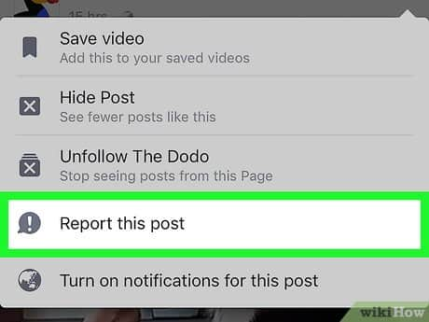


How to report
Use the social media app’s built‑in reporting tools, look for the three dots.
Block the criminal’s account to prevent further contact.
Report the scam to Report Fraud at www.reportfraud.police.uk
Tell a trusted adult.
Notes:
We’ve mentioned reporting but here’s how you how you can actually do it.
Use the social media app’s built‑in reporting tools, look for the three dots.
Block the criminal’s account to prevent further contact.
Report the scam to Report Fraud at www.reportfraud.police.uk
Tell a trusted adult.

Slide 31
Thank you for attending.
Please remember:
If you have responded to a scam, it isn’t your fault.
Anyone can be a scam victim.
Support your friends if they have responded.
Notes:
Thank you for attending today’s assembly.
Some thoughts to leave on:
Please remember that if you have responded to a scam it isn’t your fault. Criminals are sophisticated and you shouldn’t blame yourself. There is a scam out there for everyone.
Anyone can be a scam victim
Support your friends if they have responded.
Show of hands who knows now what they are going to do different going forward. Pick a couple of volunteers.
If time at the end, ask if any of the students or teachers have any questions.
END

