Slide 1


Young Friends Against Scams – eCommerce

Slide 2
Learning Objectives:
You will learn what eCommerce is
You will learn how criminals use the rise of online shopping to steal money
See some examples of how criminals steal information and money through online shopping and streaming websites
You will learn how to stay safe when shopping online
Notes:
Read out the learning objectives.

Slide 3
Let’s talk. What is eCommerce?
Notes:
Ask them to see if they know what it is, correct answer is any online shopping

Slide 4




Hands up who has used…
Notes:
Ask for a show of hands.
96% of 13–18-year-olds buy things online as getting a debit card feels like a new rite of passage.
61% have used their own debit cards to buy goods online.

Slide 5

What is eCommerce?
eCommerce is the process of buying and selling goods and services on an online platform, instead of a physical shop
Many large companies have moved towards setting up online shops as we enter an ‘online age’
Notes:
Read out the slide on what eCommerce is

Slide 6
Let's think…
Online shopping allows criminals to scam consumers
True
True
False
Online shopping means consumers do not see the item they are buying until they have paid
Notes:
Interactive slide

Slide 7
How does the rise of online shopping lead to scams?
Online shopping means that consumers do not get to see the item they are buying in person until it has already arrived at their home
Criminals can pose as legitimate sellers, and consumers may be paying money for an item that the criminal is pretending to sell
Notes:
Read slide

Slide 8
How does the rise of online shopping lead to scams?
This scam often happens where the consumer pays money for the item and it never shows up, or comes damaged/different to what they ordered
These criminals may even post ads for their goods on legitimate sites such as Amazon or Vinted
Notes:
Read slide

Slide 9
How does the rise of online shopping lead to scams?
They may have the items to sell but charge over the market value for the item, which is considered fraud
They may also use phishing emails to try and gain access to consumers accounts, and purchase goods using the consumers money to resell at a higher value to gain money for themselves
Notes:
Read slide

Slide 10
Let’s look at some examples…
Notes:
Ask the students if they can think of any examples of these scams

Slide 11

Example of Amazon Scam - Fake Listing
Notes:
Play the video

Slide 12
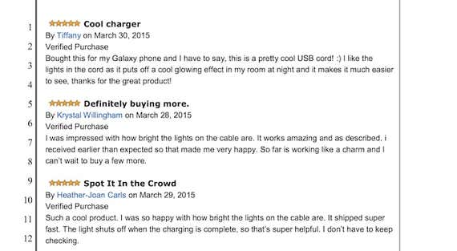
Example of Amazon Scam – Fake Reviews
To spot a fake review, look out for:
Very brief 5-star reviews with no writing
A listing with multiple reviews on the same day
A listing with very few reviews compared to other similar products
Reviews that lack a ‘Verified Purchase’ label
Notes:
How to spot a fake review online

Slide 13
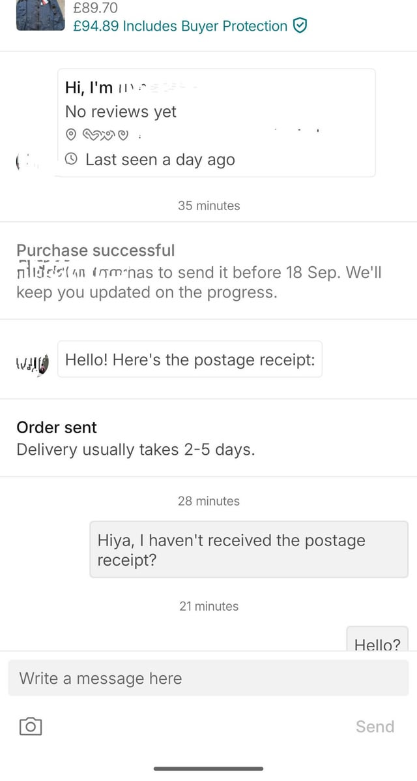
Example of a Vinted scam - Ghosting
Some common scams on Vinted include phishing attacks that try to steal your account and bank details through malicious links and product fraud where fake items are being promoted
Criminals also sometimes ghost buyers after the money has been sent, as seen in the image to the left. This means they stop all contact and never send the item they advertised after the victim has paid.
Notes:
How to spot a ghosting scam

Slide 14

Gift Card Scams
Gift cards represent an opportunity for criminals to scam consumers as they are less traceable than bank transfers.
Criminals will often ask for payments for goods or services they provide through gift cards.
Notes:
Ask if they have ever used or received a gift card
Read out the slide
30& of young people buy goods online with gift cards

Slide 15
Gift Card Scams
They tell the victim to go into their local shop and buy hundreds of £ worth of gift cards to then provide the criminals with the code, and the criminals use up all the money on the cards.
Notes:
Read out the slide
30& of young people buy goods online with gift cards

Slide 16
Let's look at some scenarios…

Slide 17
Scenario 1
You are looking to buy a new item on Amazon. Your friend tells you to check the reviews before paying for it. When you look at the reviews, there are a lot of blank accounts giving 5-star ratings and no ‘Verified Purchase’ labels.
Should you:
A: Buy the item anyway because you have already found someone selling it
B: Do some more research before deciding
C: Not buy the item from anywhere
Notes:
Read out the scenario and ask for a show of hands for each answer
Correct answer is B

Slide 18
Answer
B: Do some more research before deciding
Notes:
The answer is B because you should not buy items with untrustworthy reviews if you can find better, but that does not mean you should just give up if it is an item you really want

Slide 19
Scenario 2
You are looking to buy something on eBay and when speaking to the seller, they ask you to pay via an amazon or apple gift card. They ask you to go into your nearest shop and buy a gift card and send them the code to access the money on there. Then they promise to send the item to you after.
Should you:
A: Say no and report the seller
B: Go to the shop and get them the gift card
Notes:
Read out the scenario and ask for a show of hands for each answer
Correct answer is A

Slide 20
Answer
A: Say no and report the seller
Notes:
The answer is A because you should not buy items with gift cards other than on the sites that the gift card is from

Slide 21
So how can you stay safe?
Notes:
Ask the students for any suggestions

Slide 22

How can we stay safe when shopping online?
Shopping online is useful, but it is important to stay safe
Never save a debit card on a shopping app such as Amazon, always enter your card details in each time you make a purchase
Notes:
Read the slide

Slide 23
How can we stay safe when shopping online?
Read reviews of the items you wish to purchase to see if it is legitimate
Research the item you want to buy on other sites to see if the price advertised is a good deal, or if the sites you are using are overcharging you

