Slide 1

Introduction slide

Slide 2
About the National Trading Standards Scams Team
Team set up in 2012 to tackle mass marketing fraud
A national team, Government funded
Works with key partner agencies such as Local Authorities, banks, international and domestic enforcement agencies and postal services
The team created Friends Against Scams, a national awareness campaign that aims to educate and raise awareness for everyone in the country about scams

Slide 3


Scale of the Business Fraud
British businesses lost £59.2 million to scams in the first half of 2021, according to UK Finance!
With limited resources and turbulent economic conditions, businesses usually prioritise innovation, growth and survival over due diligence, internet controls and risk mitigation, which leaves them particularly vulnerable to fraud
Business fraud can come from anywhere: internal staff, customers, suppliers or unconnected third parties

Slide 4


Take Five to Stop Fraud
Criminals are experts at impersonating people, businesses and the police.
They spend hours researching your business for their scams, hoping you’ll let your guard down for just a moment.

Slide 5

Take Five to Stop Fraud
Stop: If you receive a request to make an urgent payment, change supplier bank details or provide financial information, take a moment to stop and think.
Challenge: Could it be fake? Verify all payments and supplier details directly with the company on a known phone number or in person first.
Protect: Contact your business’s bank immediately if you think you’ve been scammed and report it to Action Fraud.

Slide 6
Types of business scams
Government grant / tax refund scams
Invoice / mandate scams
CEO scams
Tech support scams

Slide 7
Government grant / refund scams
You may be contacted by phone, email or post by criminals seeking your business’s financial information
HMRC Tax refund/relief
Government grant for businesses
Impersonation of government agencies

Slide 8
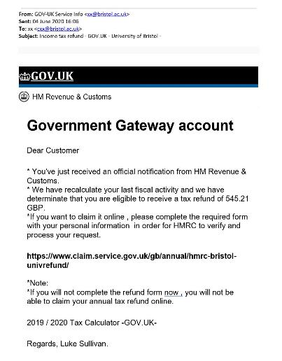
Government grant / refund scams
Not personalised
Non government email address
Spelling mistakes
Promise of reward
Contains links to false website
Creating a sense of urgency
No official signature

Slide 9
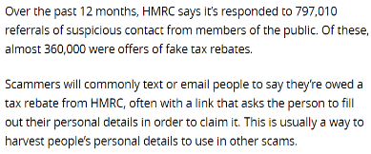
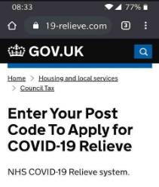


Government grant / refund scams
Which? magazine article from November 23rd 2021:
Official email from HMRC sent to businesses on 20/04/20
Website address inconsistent with other government URL’s
Poor grammar

Slide 10
How to protect yourself and your business
STOP: Be cautious about unexpected urgent communications offering financial assistance. Take a moment to think about where this message has come from
CHALLENGE: Check that the information is genuine by using official government websites
PROTECT: If you think you have been scammed, contact your bank immediately and report any suspicious communication to Action Fraud
Check the Government official website for more information by typing www.gov.uk directly into your browser

Slide 11
Invoice / mandate scams
In 2019, UK Finance reported that businesses had lost over £82m to invoice/mandate fraud
You receive a request out of the blue to change the bank details of an existing supplier
You receive more frequent than usual or duplicate invoices for a product or service
You could also be contacted and supplied a false invoice that is under your authority limit

Slide 12
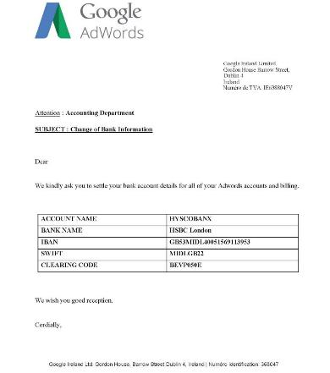
Invoice / mandate scams
Company logo designed to add validity to the communication
Genuine address used to add validity to the communication
Asking for an unusual financial request
‘Adwords’ instead of ‘AdWords’. Small grammatical errors
Not addressed to anyone in particular
Unusual English used, could be translated from another language
No sign off

Slide 13
How to protect yourself and your business
STOP: Think about what you are being asked to do. Do you have an account with this company?
CHALLENGE: Could this be fraudulent? Contact the company using a phone number or an email that you have used before to ensure that it is a genuine request. If in any doubt, contact your manager
PROTECT: If you believe you’ve fallen for a scam, contact your bank immediately on a number you know to be correct and report any suspicious communication to Action Fraud
Never rush to make a payment.

Slide 14
CEO scams
This is a sophisticated scam that plays on the authority of company directors and senior managers. The average loss to a CEO scam is £35,000
You receive text message or email from someone claiming to be a senior staff member
They ask you to make an urgent payment to a new account and instil a sense of panic
They may hack into a staff email account or use spoofing software to appear genuine

Slide 15






CEO scams & the impact
THE START
THE PHISH
THE RESPONSE
THE DAMAGE
THE RESULT
Criminals research a company in order to impersonate a CEO or senior figure within the business
Spoofed emails are sent to employees in the organisation
Employee with authority receives the communication and acts on the sense of emergency without questioning the source
The scam has been successful and the criminal now has received a payment or has access to important company information
Following a successful scam, the results can be damaging:
Financial loss
Disciplinary procedures
Potential loss of reputation
Time consuming investigations
Criminals can spend months gathering information on the company in order to improve their chances of success
Sounds pretty urgent, I’d better do that straight away

Slide 16
How to protect yourself and your business
STOP: Be cautious about unexpected urgent requests for payment or sensitive information by email, particularly where the sender says they are not available to confirm details.
CHALLENGE: Always check the request in person if possible, or by phone – make sure to use a verified number rather than the one in the request.
PROTECT: Follow internal procedures for approving new payments and be suspicious of requests to deviate from this. Report anything suspicious to Action Fraud.
Never rush to make a payment.

Slide 17
Tech support scams
With more people working remotely and IT systems under pressure, criminals may impersonate well known companies and offer to repair devices.
You receive a phone call or email offering to fix an issue such as a slow connection or software problem.
You may be asked to make an advance payment, share login details or download software
Criminals are trying to gain access to your computer or get you to share passwords and login details

Slide 18

Tech support scams
Caller will try and instil a sense of panic and demand payments to fix issues that don’t exist
They may ask you to give them access to your PC via a piece of software
Once you have given them access, they can search your hard drive for valuable information
They may ask you to login to your bank account and could obtain your banking details through remote access
Recording from the Federal Trade Commission (FTC) in the USA

Slide 19
How to protect yourself and your business
STOP: Be suspicious of cold callers claiming to be from major companies or your company’s IT department offering any form of technical support
CHALLENGE: Genuine companies would never contact you out of the blue and ask for financial information, passwords or login details
PROTECT: Never install any software, or grant remote access to your computer as the result of a cold call. If you think you’ve been scammed contact your business’s bank immediately and report it to Action Fraud.
Use your companies IT department (if you have one) or ask trusted friends or colleagues for recommendations.

Slide 20
How to protect your company from cyber attacks
A short video from the National Cyber Security Centre (NCSC) on how to protect your computers.

Slide 21
Scams are the product of organised, predatory criminals…
…who gain trust to exploit and steal money.
Use befriending and grooming techniques
Appear legitimate
Helpful
Persuasive
Persistent
Friendly
Charming
Threatening
Aggressive
Intimidating

Slide 22



Report
If you think that your company has been scammed then you should report it to the bank as soon as the discovery has been made, they may be able to stop the payment
Report all scam and fraud attempts directly to Action Fraud on 0300 123 2040 or the Police on 101 if you live in Scotland. You can also report online

Slide 23
Consequences of falling for scams…
Loss of revenue, could lead to bankruptcy
Potential investigations
Loss of time
Potential loss of reputation / trust
Potential data breach
Poor mental, physical or emotional health

Slide 24

Further reading…
Cyber security advice from the National Cyber Security Centre for small to medium sized organisations – click here
Advice from the NCSC on working from home - click here
Take Five is a fraud awareness campaign from UK Finance. For their business toolkit – click here
Action Fraud’s advice on impersonation and mandate fraud– click here

Slide 25
Thank you
Thank you for completing the Businesses Against Scams Training!
To find out about general scams that you could be seeing at home and to help protect your friends and family please become a Friend at:
www.friendsagainstscams.org.uk

