Slide 1

Goals for this campaign
Comments from the team
In phase three for the #NoBlameNoShame campaign, the team wants to achieve the following statements.
Raise awareness of the tactics that criminals use to defraud victims.
Explain the different types of vulnerability and how they can make victims more susceptible to scams.
Raise awareness of current areas of vulnerability in the UK.
Promote coercive control training to appropriate audiences and guide people to watch the short video and/or the training video.

Slide 2
Comments from the team
This social media pack has been designed to be used by supporters, organisations, partners, and Friends Against Scams directly.
Each of the following pages will have suggested text for a social media post and an accompanying infographic/image.
We have created multiple versions of each post, to accommodate the character limit on X (Twitter). If the slide has an X logo, the suggested text is 280 characters or less. All other slides are suitable for Facebook, LinkedIn or other suitable social media platforms. We have also provided carousel style posts – there is no X version for this as the platform does not support the required number of images.

Slide 3
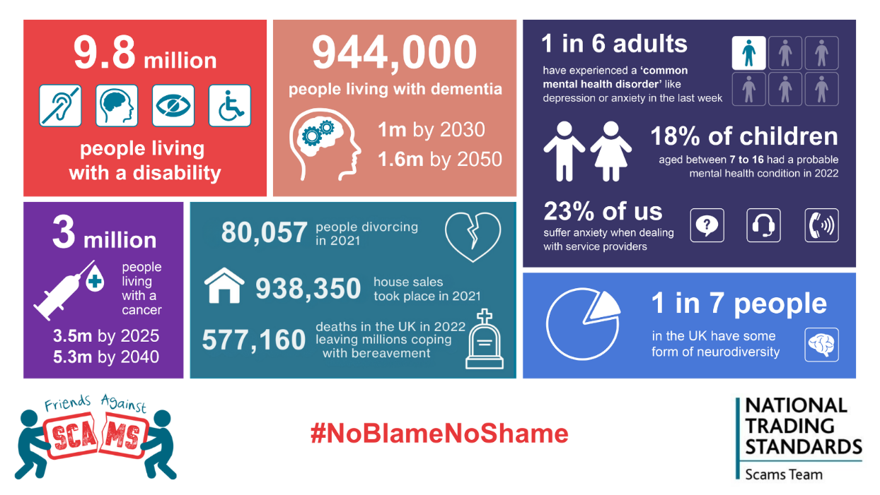
Suggested text:
Vulnerability isn’t always permanent; it often arises from life events like
➡️Bereavement
➡️Illness
➡️Job loss
➡️Divorce
During these times, people are more susceptible to scams. Situational factors like low income, poor mental health, or limited digital skills increase the risk.
To learn more visit www.friendsagainstscams.org.uk/coercive-control
#NoBlameNoShame

Slide 4
Suggested text:
Vulnerability isn’t always permanent; it can arise from life events like
➡️Bereavement
➡️Illness
➡️Job loss
➡️Divorce
➡️Moving home
During these times, people are more susceptible to scams.
To learn more visit www.friendsagainstscams.org.uk/coercive-control
#NoBlameNoShame

Slide 5
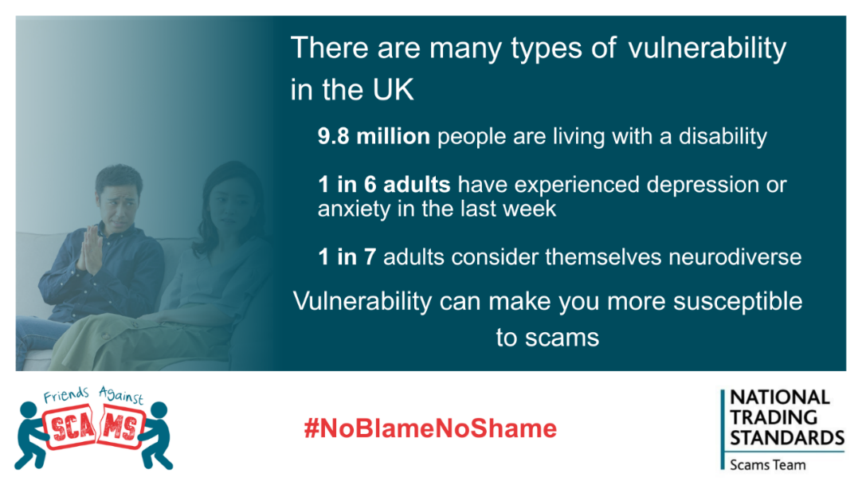
Suggested text:
⚠️ Vulnerability may arise from various factors including
✔️ Long-term health issues e.g. disability, addiction, cognitive or mental health conditions
✔️Major life events such as bereavement, job loss, or divorce
✔️ Low resilience causing difficulty coping with financial or emotional shocks
✔️ Capability challenges like poor literacy or digital skills, low confidence, and language barriers
✔️ Circumstantial factors including low income, debt, caring responsibilities
✔️ Age-related challenges like ill health, unfamiliarity with technology or a lack of life experience.
🚨Vulnerability increases the risk of scams and fraud🚨
To learn more visit www.friendsagainstscams.org.uk/coercive-control
#NoBlameNoShame

Slide 6

Suggested text:
Vulnerability may arise from various factors
✔️Long-term health issues
✔️Major life events
✔️Difficulty coping with shocks
✔️Poor literacy or digital skills
✔️Age-related challenges
Vulnerability increases the risk of scams and fraud.
Learn more at tinyurl.com/coercecontrol
#NoBlameNoShame

Slide 7
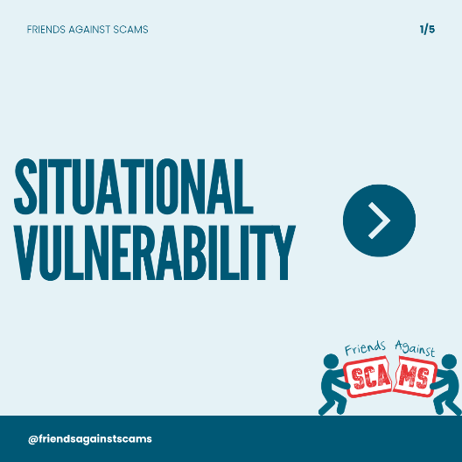




Suggested text:
We all experience vulnerability at different times whether that’s during a bereavement, a divorce, or a period of ill health.
We often say that people are not vulnerable, it’s their situation that causes it. The situation may change, so the period of vulnerability can be temporary.
Vulnerability increases the risk of fraud and scams.
To learn more visit www.friendsagainstscams.org.uk/coercive-control
#NoBlameNoShame

Slide 8
Suggested text:
🚨Vulnerability increases the risk of fraud and scams🚨
We often say that people are not vulnerable, it’s their situation that causes it. The situation may change, so the period of vulnerability can be temporary.
To learn more visit tinyurl.com/coercecontrol
#NoBlameNoShame

Slide 9

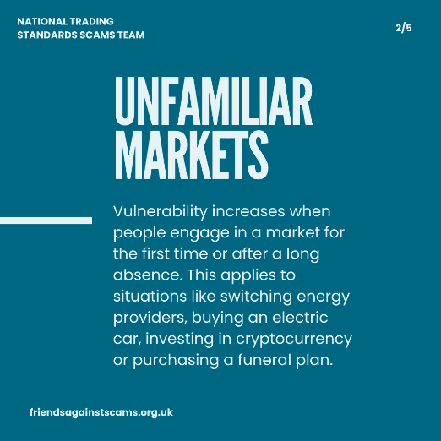
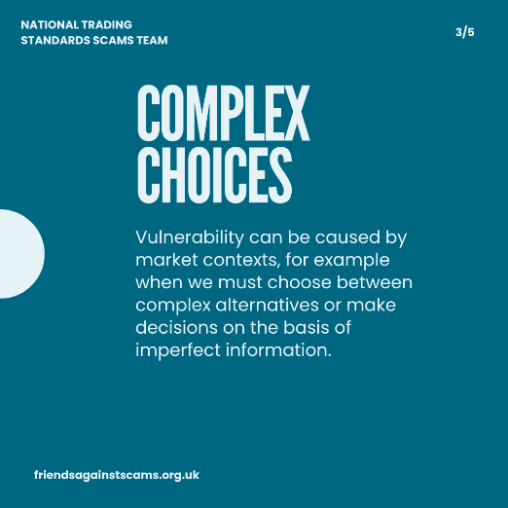
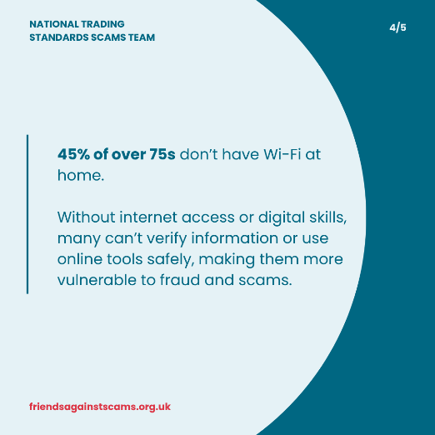
Suggested text:
🚨Vulnerability increases the risk of fraud and scams. 🚨
Vulnerability can be caused by market contexts. For example when we must choose between complex alternatives or make decisions based on imperfect information.
Some examples include:
✅Switching gas or electricity providers
✅Switching bank accounts
✅Buying an electric car
✅Buying a funeral plan
✅Investing in cryptocurrency
To learn more visit www.friendsagainstscams.org.uk/coercive-control
#NoBlameNoShame

Slide 10
Suggested text:
🚨Vulnerability increases the risk of fraud and scams. 🚨
You are vulnerable when:
✅Switching gas or electricity providers
✅Switching bank accounts
✅Buying an electric car
✅Buying a funeral plan
✅Investing in cryptocurrency
Learn more tinyurl.com/coercecontrol
#NoBlameNoShame

Slide 11
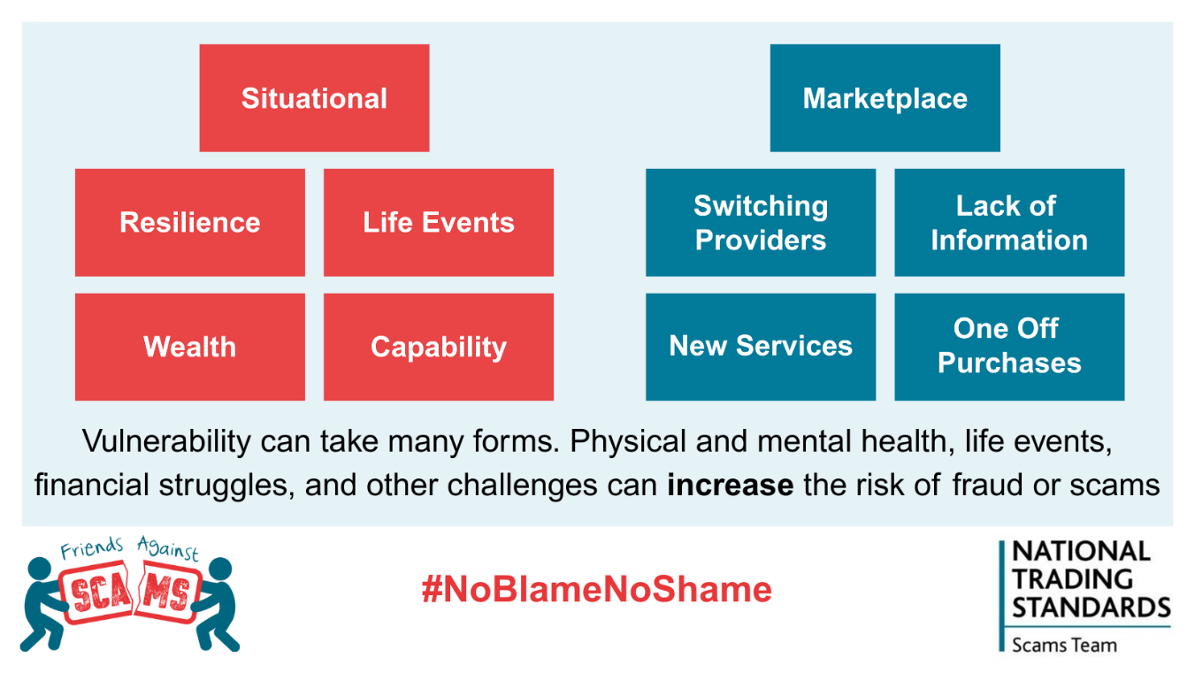
Suggested text:
⚠️Situational vulnerability stems from life’s challenges, like job loss, family issues, having a baby, death, divorce, moving home, cognitive impairment, mental health.
⚠️Marketplace vulnerability happens when making difficult or unfamiliar decisions, like changing utility providers or engaging with new services.
🚨Both increase the risk of scams and fraud🚨
To learn more visit www.friendsagainstscams.org.uk/coercive-control
#NoBlameNoShame

Slide 12
Suggested text:
⚠️Situational vulnerability comes from life challenges like job loss, divorce, or mental health.
⚠️Marketplace vulnerability arises with tough or unfamiliar choices, like switching providers.
🚨Both increase the risk of scams and fraud🚨
Learn more: tinyurl.com/coercecontrol
#NoBlameNoShame

Slide 13
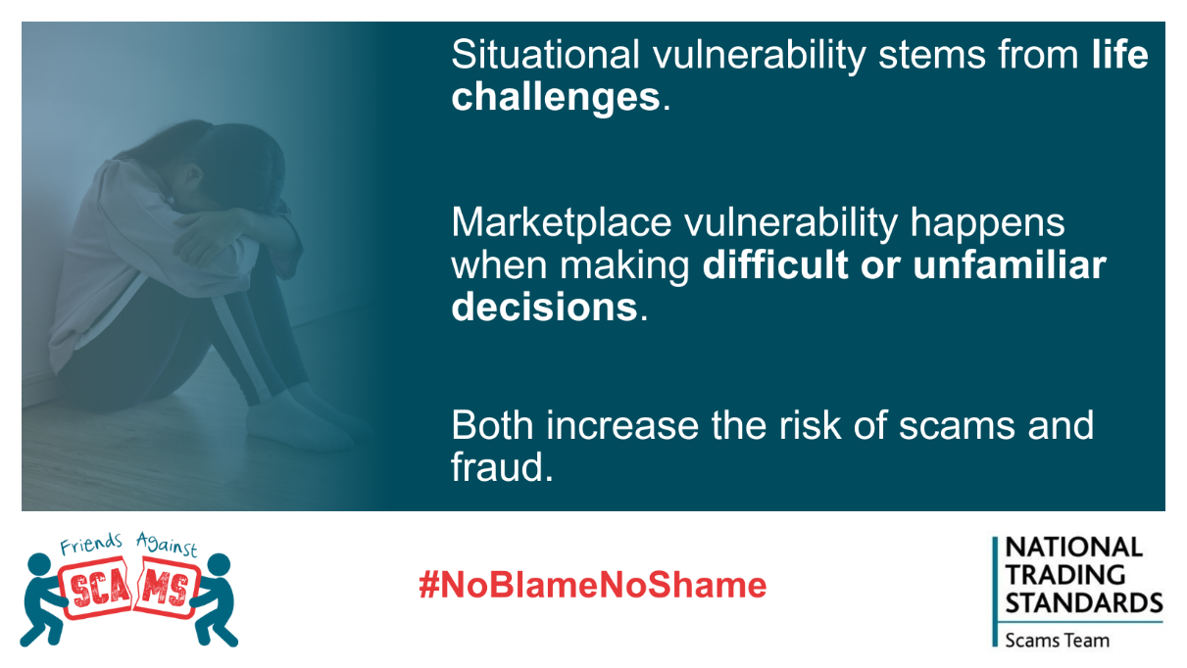
Suggested text:
Suggested text:
⚠️ Vulnerability may arise from various factors including
✔️ Long-term health issues e.g. disability, addiction, cognitive or mental health conditions
✔️Major life events such as bereavement, job loss, or divorce
✔️ Low resilience causing difficulty coping with financial or emotional shocks
✔️ Capability challenges like poor literacy or digital skills, low confidence, and language barriers
✔️ Circumstantial factors including low income, debt, caring responsibilities
✔️ Age-related challenges like ill health, unfamiliarity with technology or a lack of life experience.
🚨Vulnerability increases the risk of scams and fraud🚨
To learn more visit www.friendsagainstscams.org.uk/coercive-control
#NoBlameNoShame

Slide 14

Suggested text:
Suggested text:
Vulnerability may arise from various factors
✔️ Long-term health issues
✔️Major life events
✔️ Difficulty coping with shocks
✔️ Poor literacy or digital skills
✔️ Age-related challenges
Vulnerability increases the risk of scams and fraud.
Learn more at tinyurl.com/coercecontrol
#NoBlameNoShame

Slide 15

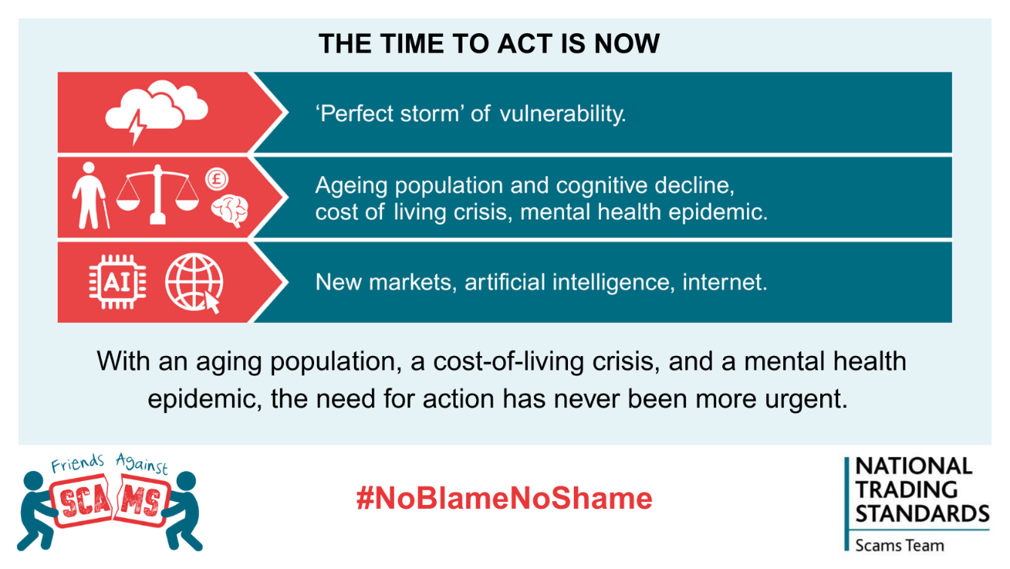
Suggested text:
The time to act is now.
🌪️We are currently facing a perfect storm of vulnerability.
👵The UK is experiencing a cost-of-living crisis, a mental health epidemic, and has an ageing population.
💻As new artificial intelligence (AI) technologies emerge and the internet continues to grow, the reality is clear: there’s a scam out there for everyone.
To learn more visit www.friendsagainstscams.org.uk/coercive-control
#NoBlameNoShame

Slide 16
Suggested text:
🌪️We are facing a perfect storm of vulnerability
👵The UK is in a cost-of-living crisis, a mental health epidemic, and an ageing population
💻 With new artificial intelligence technology and a growing internet, there’s a scam for everyone
Learn more tinyurl.com/coercecontrol
#NoBlameNoShame

Slide 17
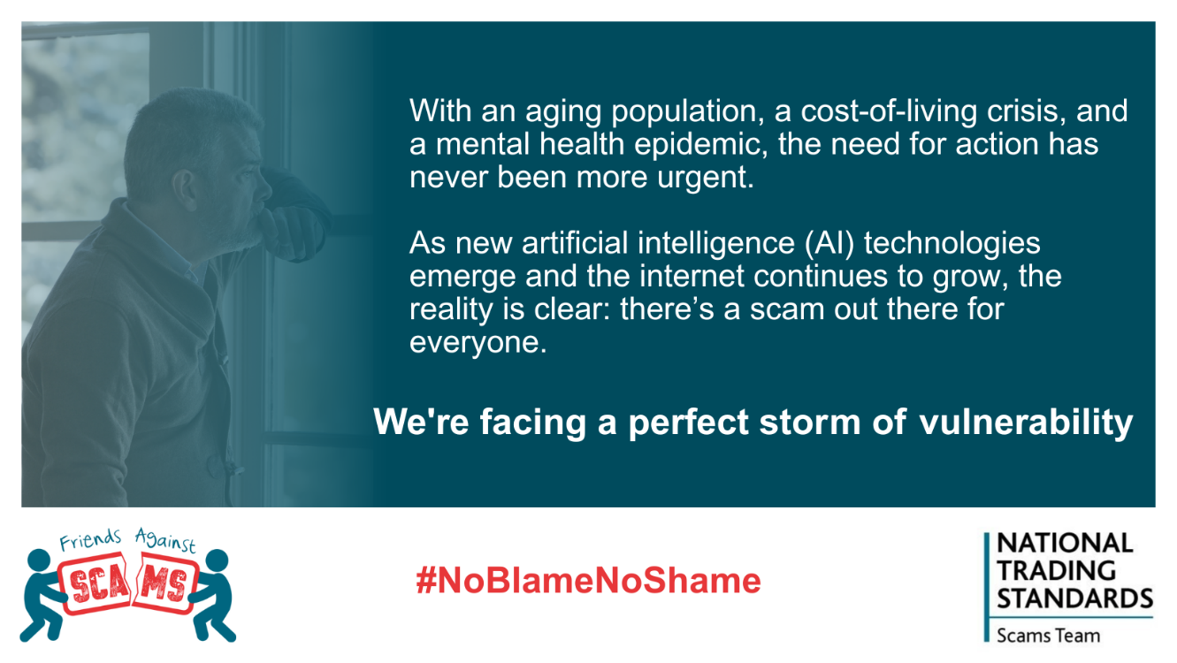
Suggested text:
The time to act is now.
🌪️We are currently facing a perfect storm of vulnerability.
👵The UK is experiencing a cost-of-living crisis, a mental health epidemic, and has an ageing population.
💻As new artificial intelligence (AI) technologies emerge and the internet continues to grow, the reality is clear: there’s a scam out there for everyone.
To learn more visit www.friendsagainstscams.org.uk/coercive-control
#NoBlameNoShame

Slide 18

Suggested text:
🌪️We are facing a perfect storm of vulnerability
👵The UK is in a cost-of-living crisis, a mental health epidemic, and an ageing population
💻 With new artificial intelligence technology and a growing internet, there’s a scam for everyone
Learn more tinyurl.com/coercecontrol
#NoBlameNoShame

Slide 19
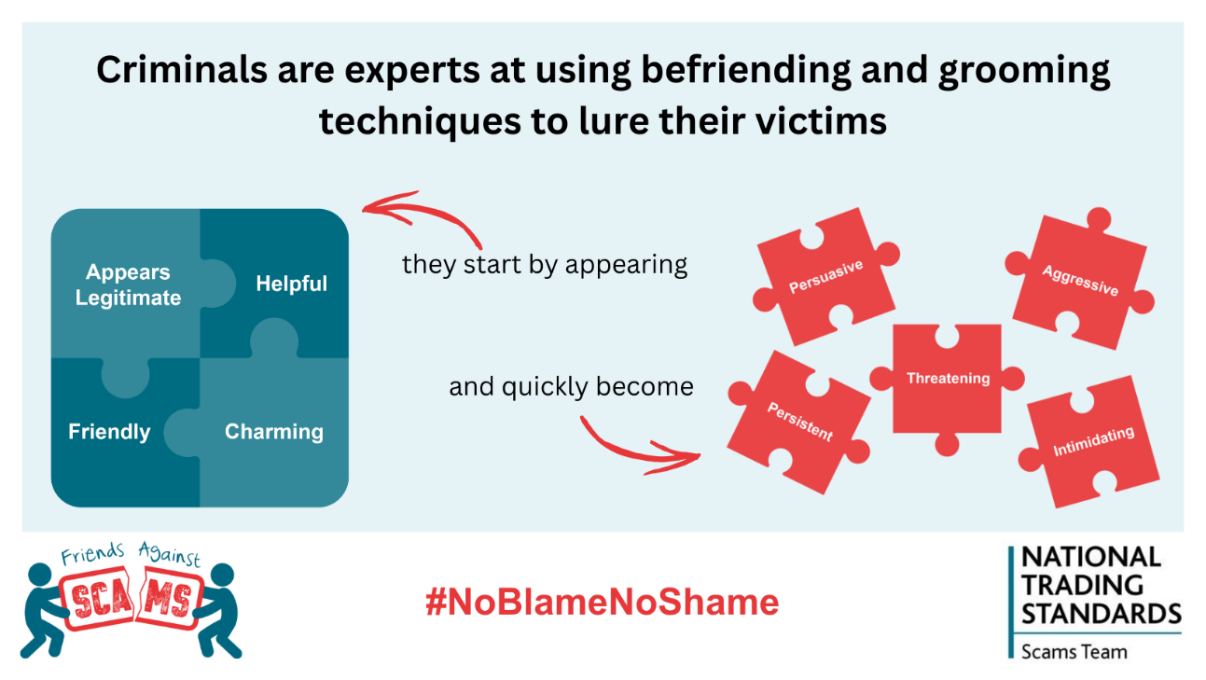
Suggested text:
🚨 Criminals use grooming techniques to lure victims 🚨
Criminals start by being friendly and helpful, then become persuasive, persistent, and aggressive.
In doorstep scams, the physical presence of the criminal at the victim's home greatly increases the ability for physical force and intimidation to be applied or to have greater access to a person’s property and belongings.
To learn more visit www.friendsagainstscams.org.uk/coercive-control
#NoBlameNoShame

Slide 20
Suggested text:
🚨 Criminals use grooming techniques to lure victims🚨
They start friendly and helpful, then become persuasive, persistent, and aggressive.
In doorstep scams, intimidation and physical force are often used as a tactics.
Learn more: tinyurl.com/coercecontrol
#NoBlameNoShame

Slide 21
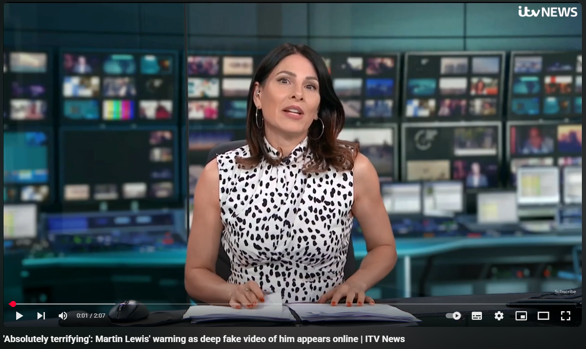
Suggested text:
🖥️This ITV report highlights how criminals use legitimacy and intimidation tactics to deceive.
🤖With rising concerns about Artificial Intelligence (AI) and its misuse, this is a timely reminder of the dark side of AI and how easily anyone can be manipulated.
👩‍💻As you watch, see if you can spot the tactics these criminals are using.
www.youtube.com/watch?v=xVwnAlUgu7k
To learn more visit: www.friendsagainstscams.org.uk/coercive-control
#NoBlameNoShame
Note: this post doesn’t have a graphic to upload. The youtube link should provide a popup on your post. As there are two links, please ensure the correct pop up is used.

Slide 22
Suggested text:
🖥️This report highlights how criminals use legitimacy and intimidation tactics to deceive.
🤖It is a timely reminder of the dark side of Artificial Intelligence (AI) and how anyone can be manipulated.
www.youtube.com/watch?v=xVwnAlUgu7k
Learn more tinyurl.com/coercecontrol
#NoBlameNoShame
Note: this post doesn’t have a graphic to upload. The youtube link should provide a popup on your post. As there are two links, please ensure the correct pop up is used.

Slide 23
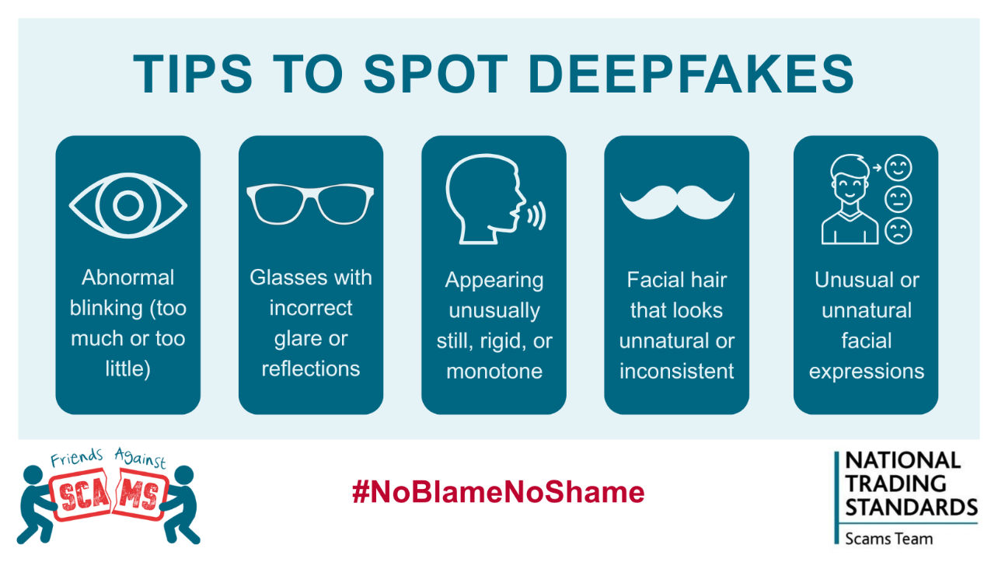
Suggested text:
Deepfakes are created by using artificial intelligence (AI) to manipulate existing footage or audio to make someone appear to say or do something they never did.
💡 5 Common Deepfake Scams
1️⃣ Investment Scams: Fake videos of public figures like Martin Lewis promoting “can’t-miss” investment deals.
2️⃣ Romance Scams: AI-created profiles build fake relationships online, then ask for money.
3️⃣ Extortion Scams: Criminals use voice cloning to pretend to be a family member in trouble, urgently asking for money.
4️⃣ Celebrity Ad Scams: Fake ads using public figures to sell products they never endorsed.
🛡️Learn how to protect yourself by becoming a Friend Against Scams www.friendsagainstscams.org.uk/online-awareness-training-video
#NoBlameNoShame

Slide 24
Suggested text:
Deepfakes use artificial intelligence (AI) to manipulate audio/video, making someone appear to say/do something they never did.
💡 Common Scams:
1️⃣ Fake investment
2️⃣ Romance scams
3️⃣ Voice cloning extortion
4️⃣ Fake celebrity ads
🛡️Learn more: tinyurl.com/coercecontrol
#NoBlameNoShame

Slide 25

Suggested text
Vulnerability comes in many forms.
🤕Sometimes it can be caused by life’s difficult circumstances, or by times when we must make tough or unfamiliar choices when making a purchase.
🚨Vulnerability increases the risk of fraud and scams. 🚨
🛡️Learn how to protect yourself by becoming a Friend Against Scams www.friendsagainstscams.org.uk/online-awareness-training-video
#NoBlameNoShame

Slide 26
Suggested text
Vulnerability comes in many forms.
🤕It can be caused by life’s difficult circumstances, or when we make tough or unfamiliar choices when making a purchase.
🚨This increases the risk of fraud and scams.
🛡️Become a Friend Against Scams: tinyurl.com/coercecontrol
#NoBlameNoShame

