Slide 1


Young Friends Against Scams
Year 7 - Assembly Session
Gaming Scams
Notes:
Introduce yourself. Explain to the students that you are going to talk to them about gaming scams.
To start off ask for a show of hands for “who plays online games here” – this could be roblox, fifa, fortnite, Minecraft or anything like that.
Thank them and say “ did you know that criminals are everywhere in gaming. Today we’re going to look at how you can stay safe from them.

Slide 2
Learning Objectives:
Understand what scams are and why criminals target young people.
Recognise common gaming scams (e.g., free skins, fake giveaways).
Learn how to protect yourself online.
Know what to do if you or a friend respond to a scam.
Notes:
Read out learning objectives
Next.

Slide 3
Would you give your best friend your password if they asked?
Hands up for Yes.
Hands up for No.
Notes:
To start off ask them this question, do a show of hands, first for yes, then for no. Say how many people for each but tell those who say no to keep their hands up.
Ask someone 2 or 3 students to keep their hands up if they’d like to share why, and share with the hall.
Next slide.

Slide 4
Criminals often pretend to be friends to get your money, personal information or access to your accounts.
Notes:
Well done to those who said no as – read slide.
You should never give your password to anyone apart from your parents or your trusted carer.
Friends accounts can also be hacked so it’s best to stay safe and never send it out.
Next.

Slide 5
What are scams?
A scam is something that has been set up to coerce and manipulate people into giving them the following:
Personal information
Money
Bank details
Passwords

Slide 6
Hands up if you have seen these examples.
Notes:
Do a show of hands, first for yes, then for no. Tell the audience an estimate of the room’s answers.
Next slide.

Slide 7
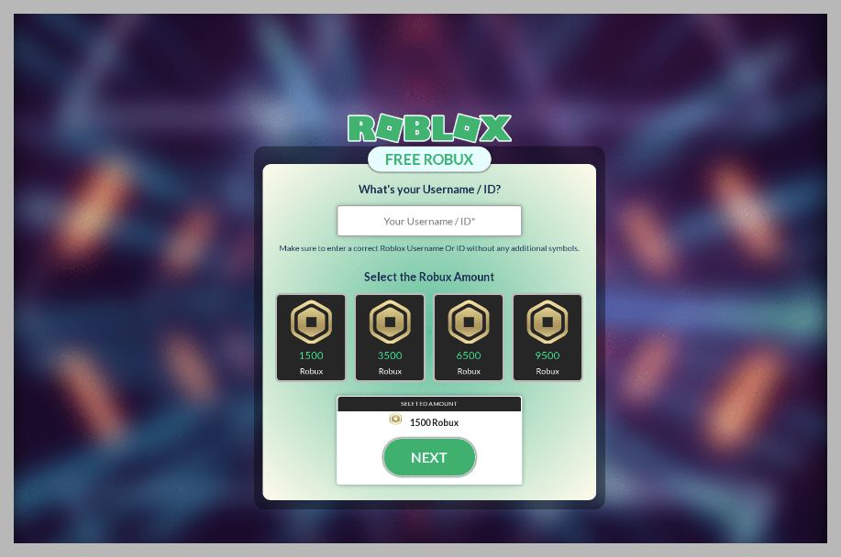
Free in-game currency
Notes:
There are websites out there which promise free premium in game currency to your account, all they ask is for you to enter your username and password of your account.
This is used to steal access to your account. Never give your login details to anyone, especially these websites.
Do not trust any of these websites, if your friends share them with you, let them know it’s fake and a scam.
As you can see this example is for Roblox.

Slide 8
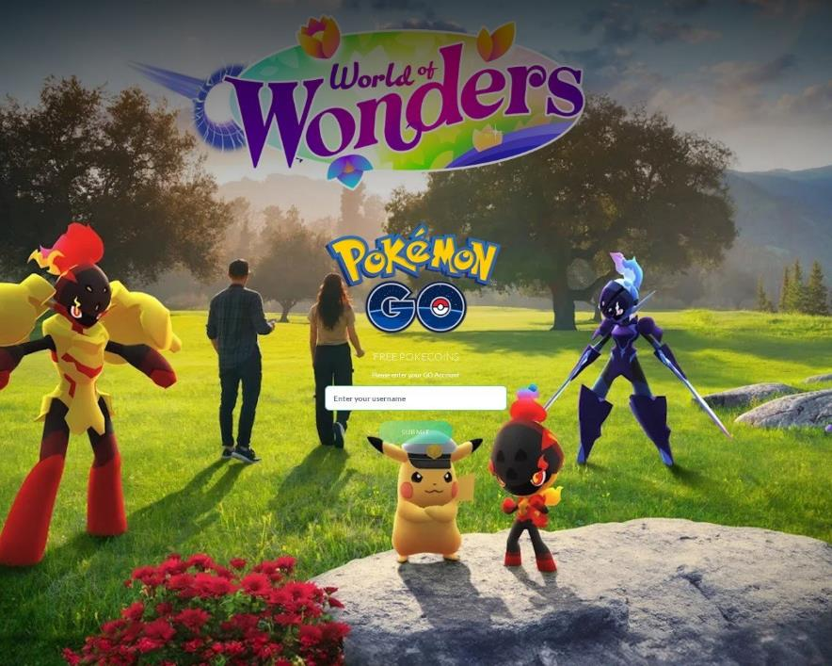
Free in-game currency
Notes:
This is the same scam as the previous one however this is for Pokemon GO

Slide 9
Free in-game currency
Notes:
And this is also the same but it is for Fortnite.

Slide 10
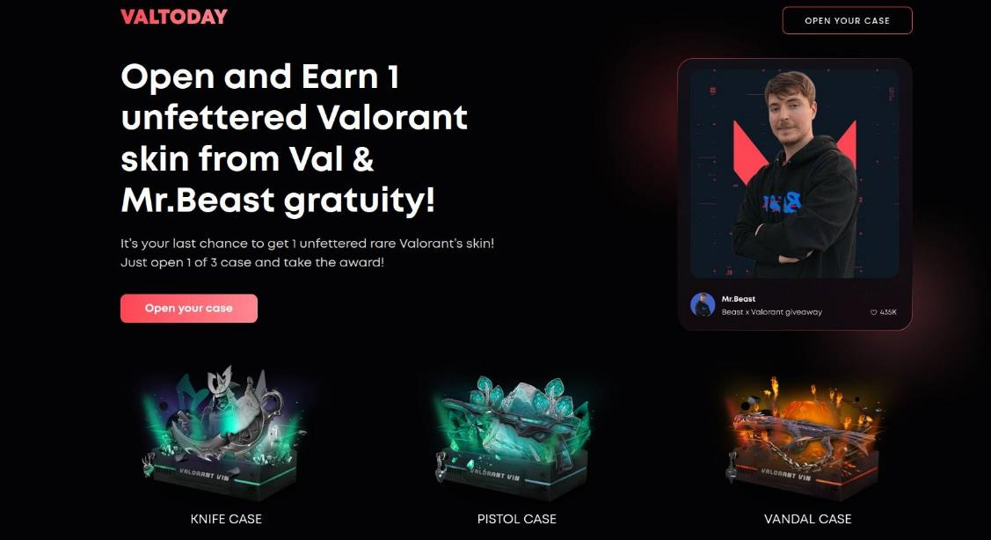
Free skins
Notes:
You may come across offers for free skins for certain games – this one being for Valorant. Again, they will ask you to enter your account details to be able to open a ‘treasure chest’ to receive your reward.
There is never a reward and you will have just given the criminals access to your account.

Slide 11
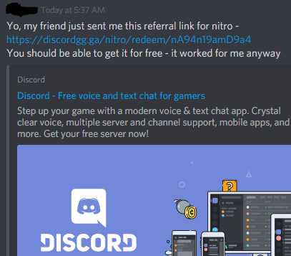
Free nitro for Discord
Notes:
Now this scam could actually come from someone on your own friends list or group chat when their own account has been hacked. Discord will never provide free nitro through a referrals link, do not click and report the message to Discord.

Slide 12
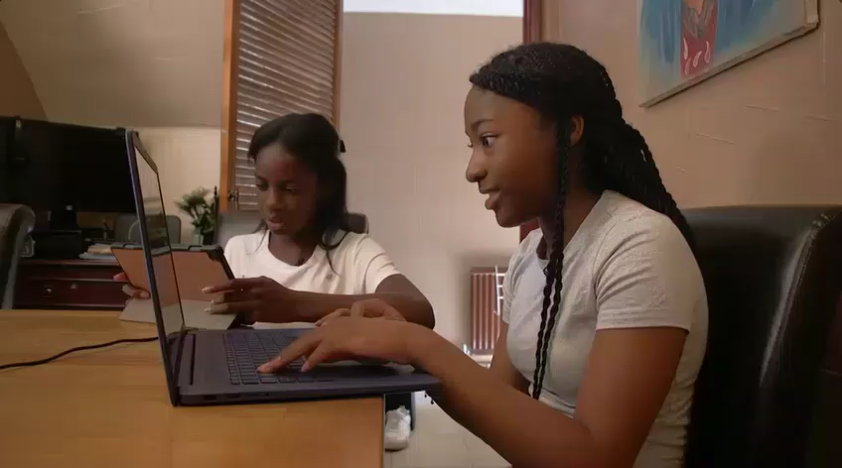
Chloe’s story
Notes:
We will now watch a video regarding Chloe’s experience with a scam on Roblox.
As you watch, have a think about where Chloe could have protected herself better.

Slide 13
Scenarios.
Notes:
“Now we will look at some scenarios.”
Read the question out to the audience then show all 3 answers, do a hands up for each one. Then show the answer.
Next slide.

Slide 14

Scenarios
You get a message on Roblox: “I’ll give you 10,000 Robux if you send me your login first.” Do you:
Send your login details
Ignore and block
Ask a friend what to do
Tip: Real Robux can only be bought through the official Roblox app or website. If a link or person offers free Robux, it’s always a scam.
Notes:
Read question
Hands up for A, hands for B, hands for C. Show answer.
Read tip

Slide 15
Scenarios
You are watching a stream and the streamer says: “I’m giving away 5,000 V-Bucks! Just click the link in the chat and sign in with your Epic account to claim!” Do you:
Share with friends so they don’t miss out
Click the link and enter your details
Report the stream and leave
Tip: Real game companies don't do giveaways through random links. Criminals even make AI videos of real YouTubers and streamers announcing fake giveaways, so seeing their face is not proof
Notes:
Read question
Hands up for A, hands for B, hands for C. Show answer.
Read tip

Slide 16
Scenarios
You are gaming online and a player says: “I’ll give you this super rare item if you go first and give me your item. I promise I’ll send mine after!”
Block them and walk away
Trust them and trade first
Ask them to trade at the same time
Tip: “Trust trades” are always scams — criminals disappear once they get your item.
Notes:
Read question
Hands up for A, hands for B, hands for C. Show answer.
Read tip

Slide 17
How to spot scams.
Notes:
Here are how you can spot scams before responding.

Slide 18
How to spot scams
When you see an offer online, stop and ask yourself 3 questions:
Is the offer unrealistic? - Free skins/coins
Is it asking for personal info – Logins, passwords, bank details
Is it rushing you to respond – “Act now or miss out!”
If the answer is YES it is almost always a scam.
Notes:
Read question
Hands up for A, hands for B, hands for C. Show answer.

Slide 19
Not a secure website.
No padlock or HTTPS
Imagery makes it look real
Asks for personal information about gaming account
Criminals use AI to write hundreds of realistic comments
Suspicious links. Do not show where link will go
Offer is unrealistic
Notes:
Read one at a time

Slide 20
How to protect yourself from scams.

Slide 21

How to protect yourself
Secure your account.
Use a strong password
Setup 2 Factor Authentication
Notes:
Use a strong password – bad examples of a strong password are pet names and something easily guessed like “12345” or the word “password”
2. 2 factor authentication will make it harder for criminals to steal your account if you accidentally give in your email and password. It is worth setting this up for every account you have.

Slide 22

How to protect yourself
Stick to official sources
Only buy game currency through the official game store or app.
Never download currency, cheats or mods from random websites.
Notes:
Read question
Only buy game currency through the official store or app as this is the only way you can get it safely.
2. Never download currency, cheats or mods from random websites – it is likely that they will ask for your login details to steal your account.

Slide 23

How to protect yourself
Be link smart
Don’t click suspicious links in chats, comments or direct messages.
If in doubt, go directly to the official site/app instead.
Notes:
Don’t click suspicious links in chats, comments or direct messages. This could lead to fake websites setup to steal your account information.
2. If in doubt, go directly to the official site/app instead – remember that the official companies will never ask for your password.

Slide 24

How to protect yourself
Think before you share
Never share your password, not even with friends.
Don’t give out personal info online (real name, address, school).
Notes:
Never share your password, not even with friends. – Keep your password secure and not easily accessible by others..
2. Don’t give out personal info – this can be used by criminals online to steal your account and can even lead to worse situations. Never share this info with strangers online.

Slide 25

How to protect yourself
Report and block
Use the in-game tools to report criminals.
Block anyone who sends dodgy links or tries to scam you.
Tell a trusted adult/teacher straight away if something feels wrong.
Notes:
Use the in game tools to report criminals – all online games should have this option.
Block anyone who sends dodgy links or tries to scam you.
As with Chloe’s story, tell a trusted adult straight away when something feels wrong.

Slide 26
Thank you for joining us today
Next steps:
After school tell a family member or friend one thing you have learned today.
Give your friends the right advice if you notice that they may be responding to a scam.
Notes:
Thank you for attending today’s assembly.
Here are some next steps you can take.
Show of hands who knows now what they are going to say when they get home. Pick a couple of volunteers.
Say well done.
If time at the end ask if any of the students or teachers have any questions.
END

